Slide 1
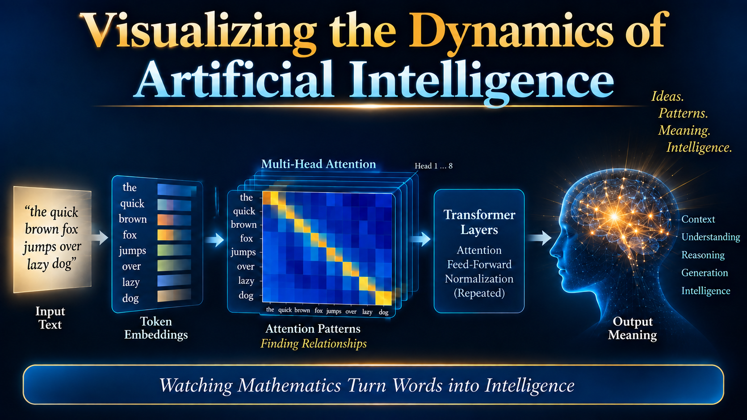
Download PowerPoint at: WordLight.org/AI.pptx

Slide 2
Presentation Roadmap
Visualizing the Dynamics of Artificial Intelligence
1
Early Development of AI Technology: Modeling Technology
2
Evolution of Development of Conceptual Knowledge and AI Electronics Technology
3
Understanding Complex AI: Making the Invisible Visible - Visualization
4
Evolution of Development of AI Architecture & Algorithms
5
Large Language Models: “Attention is All You Need” – The AI Transformer
6
Visualizing the Dynamics of AI Processes
7
Laboratory Model of AI Architecture → Demonstrations/Animations:
8
Illustrations of Some Basic Concepts/Dynamics of AI: Number → Embeddings

Slide 3

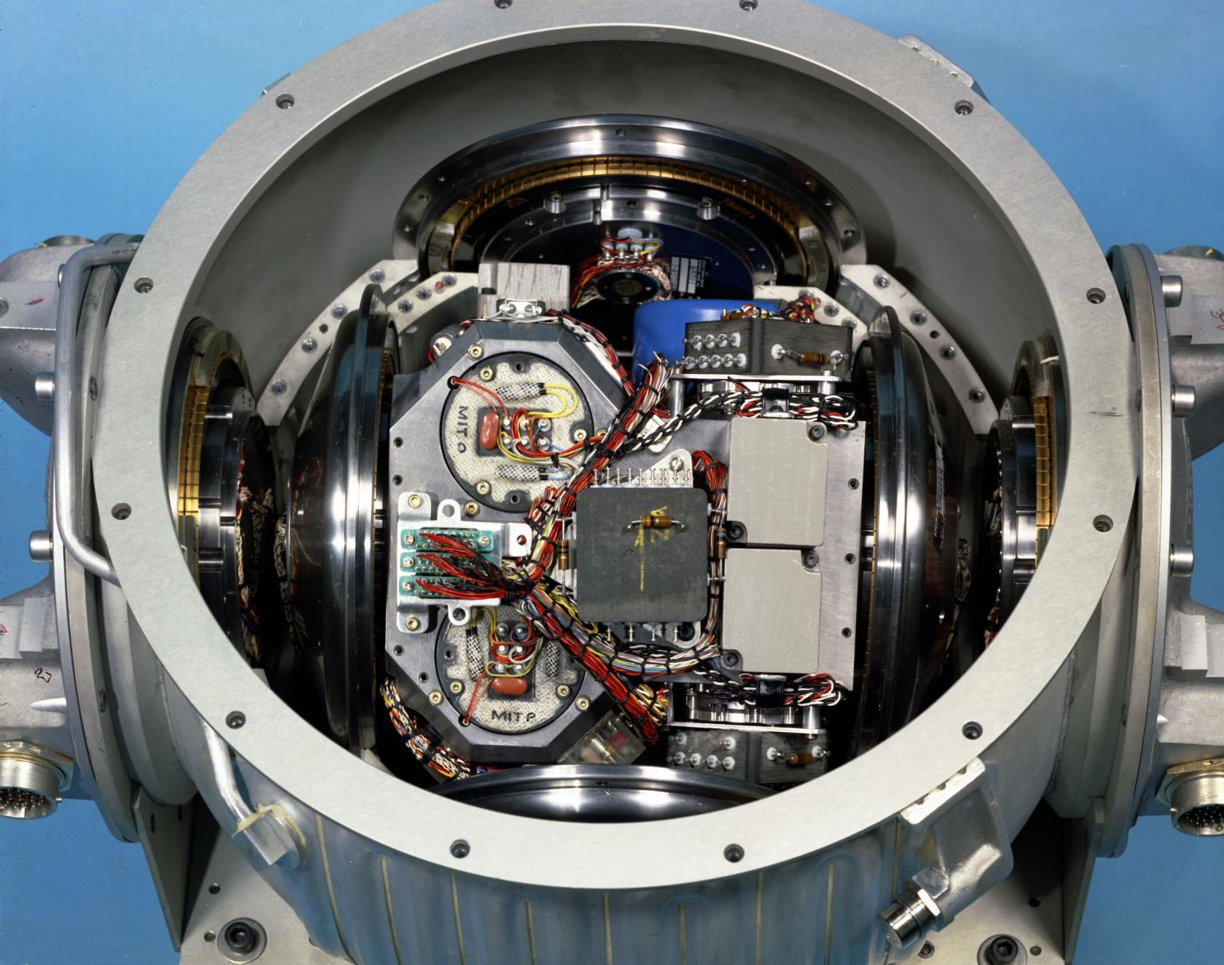
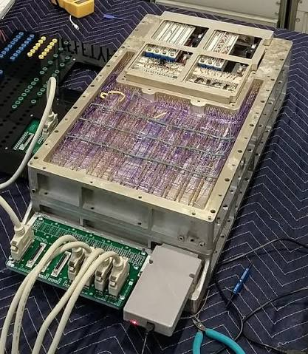
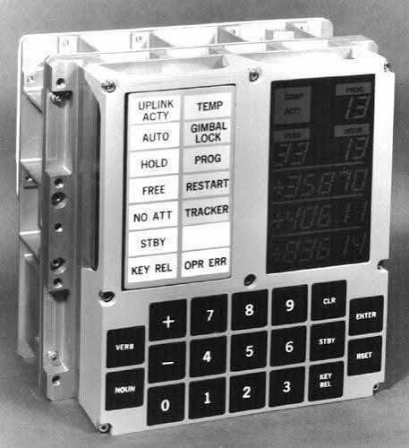
Background: AC Electronics Sub-Contractor to NASA
Apollo LEM Inertial Measurement Unit
Apollo LEM
Guidance Computer
2,800
NOR Gate
ICs
LEM Display
And Keyboard
Why am I standing here before you? Gifts…

Slide 4
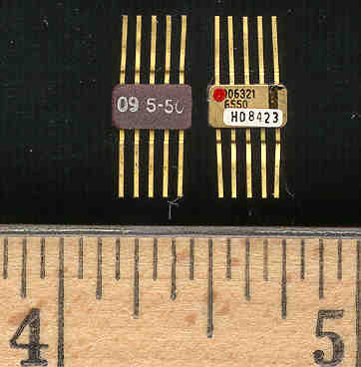
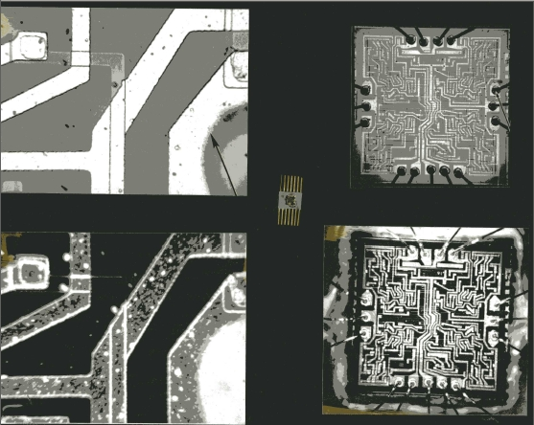
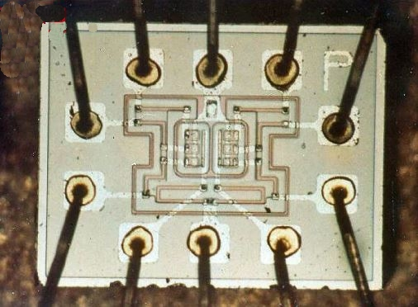
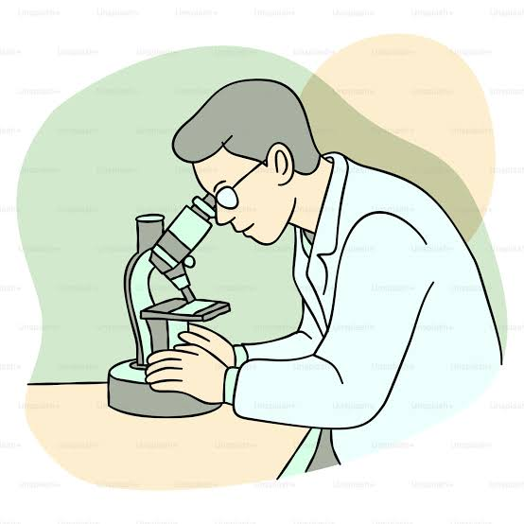
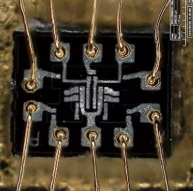
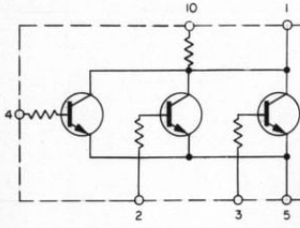
Guidance Computer Integrated Circuits
Analyst – Semiconductor/Integrated Circuit Analysis
Analyst
Tom

Slide 5


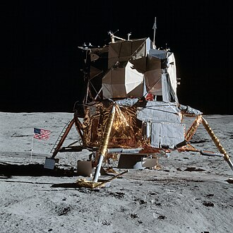
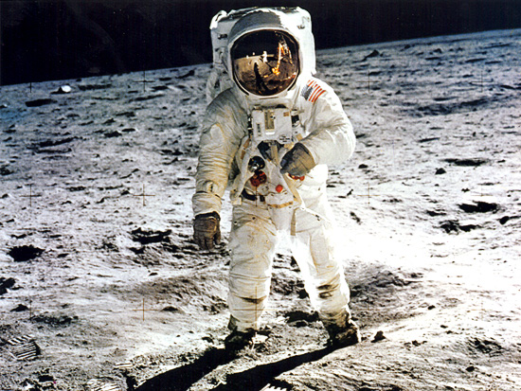
Lunar Excursion Module (LEM)
Inertial Measurement Unit -→
Guidance Computer
Buzz Aldrin
7-20-1969

Slide 6
MY WORK HISTORY — FROM EARLY ICs TO
THE FOUNDATIONS OF MODERN AI
I entered the semiconductor field when integrated circuits were still in their formative years.
Near the beginning of the integrated-circuit revolution → a technological foundation of modern AI
1966–1972 • ANALYST
APOLLO SPACE PROGRAM
• Analyst — ICs in the LEM Guidance Computer
• Direct exposure to early integrated-circuit computing
• Apollo-era computing showed what IC technology could make possible
R&D • SEMICONDUCTOR PHYSICS
• Semiconductor / device innovations
• Optimization of transistor design
• Math- and physics-based analyses
• Senior Physicist — 37-year career
THE CONNECTION TO AI
• Modern processors and GPUs are built from the same underlying semiconductor technology
• Decades of IC scaling enabled vastly greater computing power
• That computing foundation helped make modern AI practical
“I didn't know it at the time, but in 1966 I had entered one of the technological streams that,
sixty years later, would make artificial intelligence possible.”

Slide 7
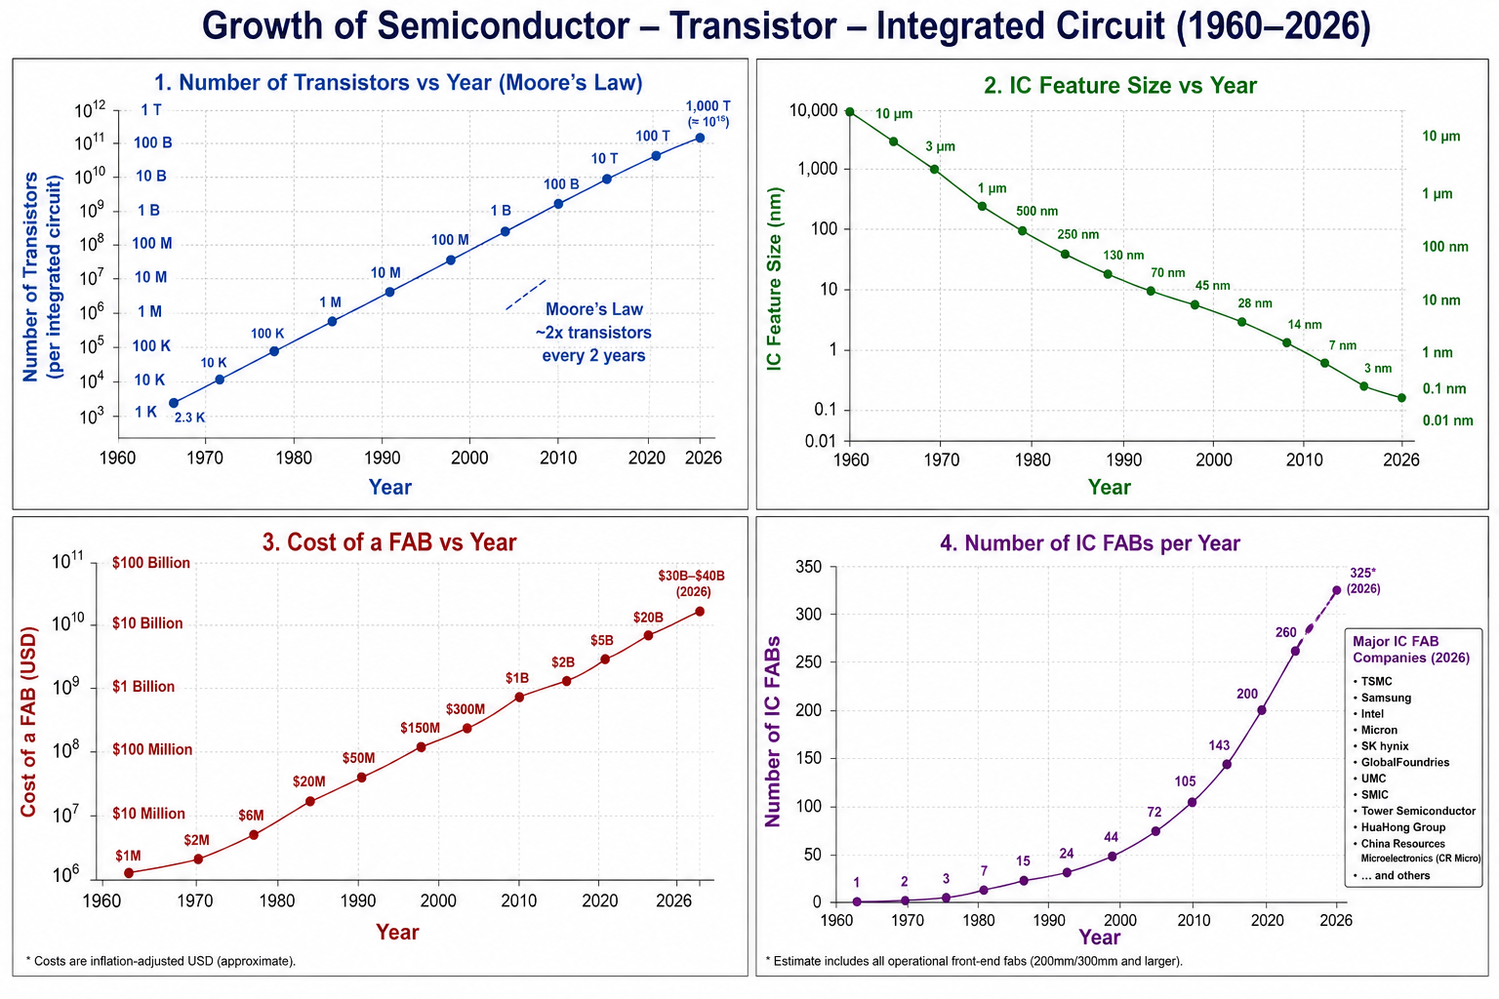
Human Red
Blood Cell
Limit of Optical
Microscope
1,000,000X
Increase
80% of IC Market
TSMC
Samsung

Slide 8
2. History of Development
of AI Technology

Slide 9
What Is AI? — A Practical Engineering Definition
Modern AI is a Trained Mathematical Model.
Mathematical neural networks,
Trained on enormous amounts of data
Using powerful processors, extensive memory, and
Billions of adjustable parameters.
During training, the system repeatedly adjusts
billions or even trillions of numerical parameters
to reduce errors in its predictions.
The resulting trained model can then
respond to new inputs without having to
search through all its original training data

Slide 10
Knowledge Amplification Factor – Tracking Conceptual Growth
A PROPOSED METRIC FOR THE GROWTH OF HUMAN KNOWLEDGE
Aₖ = New usable knowledge produced /Human intellectual effort required
$$A_{K}\left(\text{pre−writing}\right)=11$$
D: DISCOVER
new knowledge:
Philosophy - Science
P: PRESERVE
knowledge:
e.g. Printing Press,
A: ACCESS
knowledge:
e.g. Internet, Hard Drive
PROCESS &
SYNTHESIZE:
Super Intelligence
×
×
×
Human Knowledge Capability Index: K(t) ∝ D × P × A × S
Aₖ emphasizes productivity: how strongly tools and institutions amplify the knowledge generated
by a unit of human intellectual effort.

Slide 11

HUMAN KNOWLEDGE CAPABILITY INDEX — LOGARITHMIC VIEW
Growth of Knowledge Capability Index vs Ages
Artificial Hyperintelligence
10,000,000
Generative AI
1,000,000
Big Data
Deep Learning
Hooks’s Law
Information / Smartphone–Cloud
100,000
Personal Computing
Internet
10,000
Integrated Circuit
Greek Mathematics & Science
Knowledge Capability Index
Charlemagne: Law and Order
Electronic Computer
Modern Science
1,000
Age of Information Technology
Industrial Revolution
Greek Philosophy
Newton–Enlightenment
100
Scientific Revolution
Printing / Renaissance
Dark Ages
Medieval Scholarship
10
Writing / First Civilizations
3500 BC
600 BC
300 BC
1000
1450
1600
1700
1800
1900
1950
1970
1990
2000
2010
2015
2020
2026
$$A_{K}\left(\text{pre−writing}\right)=11$$
NONLINEAR / COMPRESSED TIME SCALE — EQUAL SPACING PER ERA

Slide 12
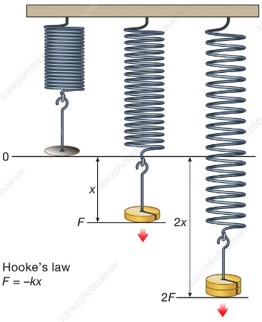
HUMAN KNOWLEDGE CAPABILITY INDEX — LOGARITHMIC VIEW
Hard Won Knowledge Capability
Artificial Hyperintelligence
10,000,000
5,000 Years:
1660
Hooke’s Law
F = k*Δx
Generative AI
1,000,000
Big Data
Deep Learning
Information / Smartphone–Cloud
100,000
Personal Computing
Internet
10,000
Integrated Circuit
Knowledge Capability Index
Greek Mathematics & Science
Electronic Computer
Modern Science
1,000
Industrial Revolution
Greek Philosophy
Newton–Enlightenment
100
Scientific Revolution
Printing / Renaissance
Dark Ages
Medieval Scholarship
10
Writing / First Civilizations
3500 BC
600 BC
300 BC
1000
1450
1600
1700
1800
1900
1950
1970
1990
2000
2010
2015
2020
2026
1
$$A_{K}\left(\text{pre−writing}\right)=11$$
NONLINEAR / COMPRESSED TIME SCALE — EQUAL SPACING PER ERA

Slide 13
HISTORY OF MATHEMATICS
AI-assisted Math
Mathematical ideas that expanded physics and computing
Computational Math
Computability
Numerical Methods
Quantum Math
Tensor Calculus
Hilbert Spaces
Vector Calculus
Riemannian Geo
Matrix Algebra
Group Theory
Probability
Fourier Analysis
Non-Euclidean
Calculus
Differential Eq.
Analytic Geo.
Algebra
Trigonometry
Geometry
The 19th century produced an extraordinary expansion of mathematics because mathematicians began exploring abstract structures beyond immediate physical applications. These discoveries subsequently became the mathematical foundations of relativity, quantum mechanics, and modern computing.”
Number
Number Theory
DATES ALIGNED TO MILESTONES • NONLINEAR / COMPRESSED TIME SCALE
3500 BC
300 BC
300 BC
820
1500
1637
1665
1700s
1700s
1820s
1822
1830
1850
1854
1880s
1900s
1915
1925
1936
1950s
1980s
2030*
*2030: outlook for AI-assisted mathematical discovery (not a dated invention)

Slide 14
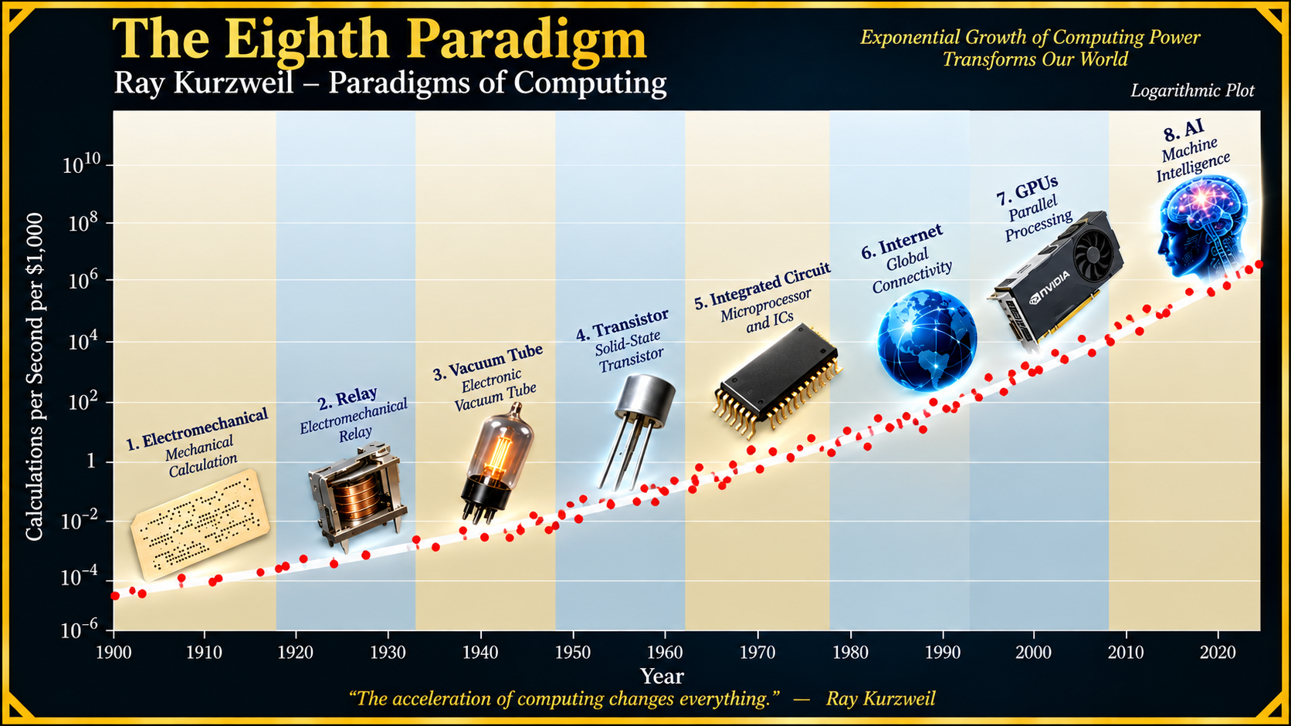
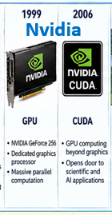
ℕumber
Paradigms of Computer Technology
126 Years of Moore’s Law
ℕumber is the Basis for Artificial Intelligence
Necessary Truth → Number → Mathematics → Physical Universe → Brain → Computer → AI
2005 “The Singularity - Trasncend”

Slide 15
Math with On/Off Switches/Relays

Slide 16
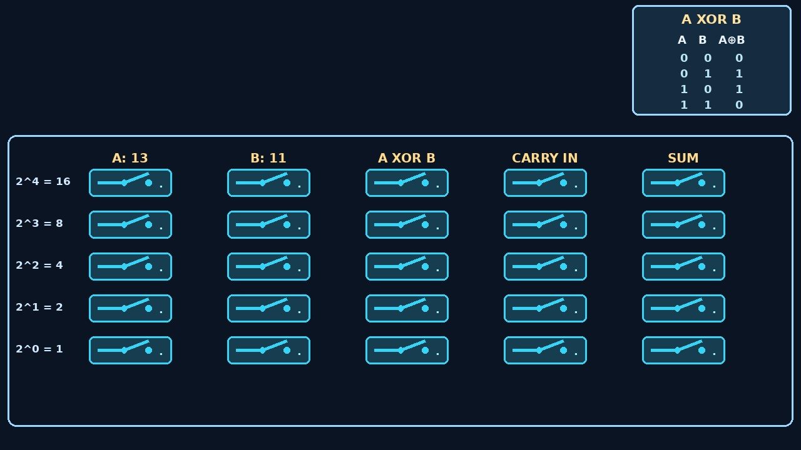
HOW SWITCHES CAN DO ARITHMETIC: ADDITION
R
U
L
E
S
13 + 11 = 24 SWITCH ARITHMETIC: | 0 = OPEN CONTACT | 1 = CLOSED CONTACT
BINARY INPUT VALUES A AND B FOR SUMMATION RELAY MATH OPERATIONS
XOR
Addition Rules

Slide 17
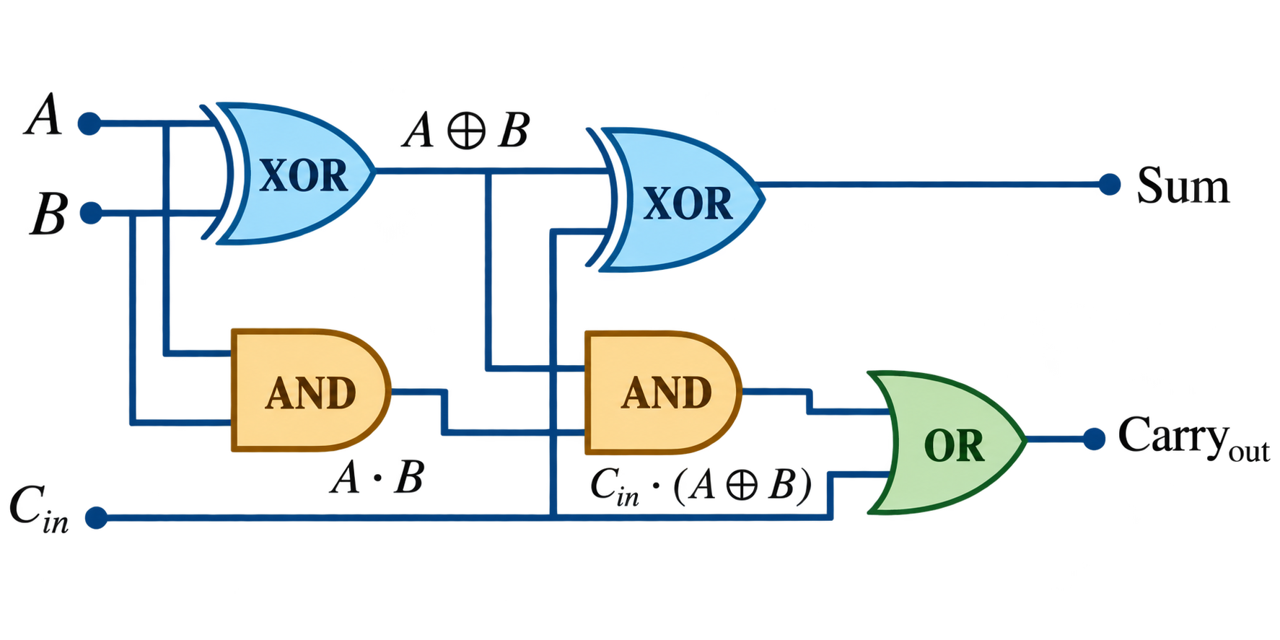
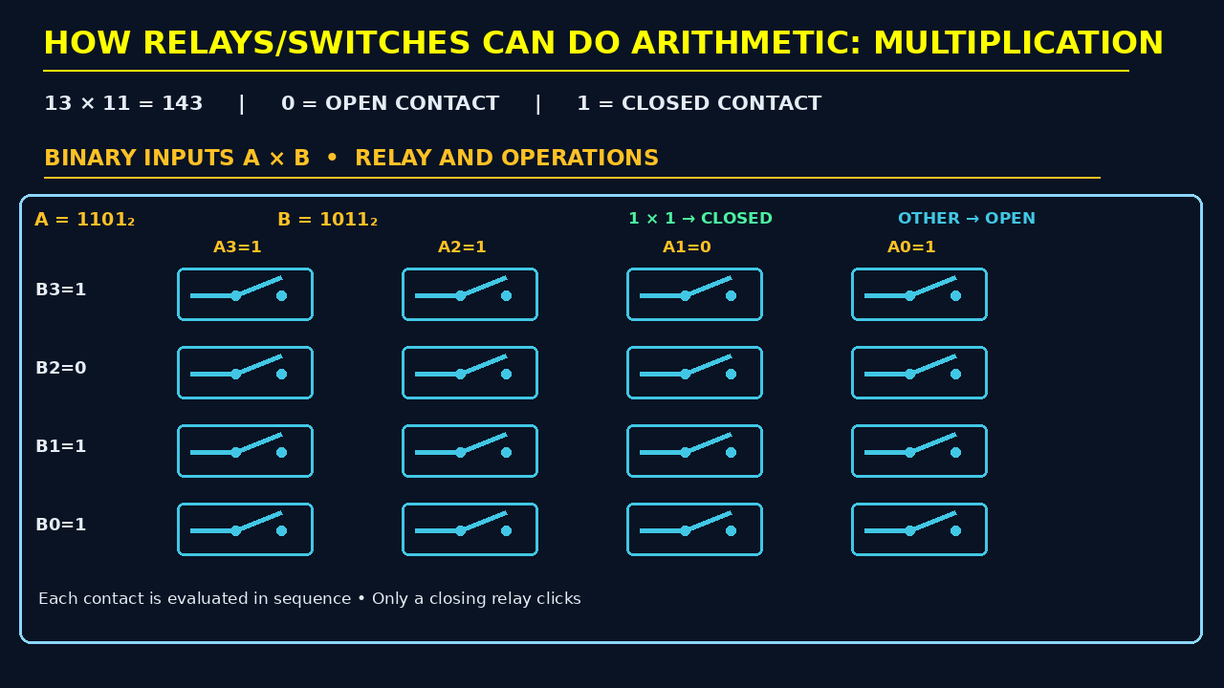

HOW GATES/SWITCHES CAN DO: MULTIPLICATION
R
U
L
E
S
BINARY INPUTS A X B RELAY/GATES AND OPERATIONS

Slide 18
CPU / μP vs GPU — ONE FAST WORKER vs MANY PARALLEL WORKERS
Why GPUs transformed modern AI
MICROPROCESSOR / CPU
GPU
A few powerful general-purpose cores
Many smaller arithmetic units working together
vs.
CORE
1
CORE
2
CORE
3
CORE
4
SERIAL
↔
PARALLEL
Best when tasks must be done in sequence
A
→
B
→
C
→
D
→
E
→
F
Best when the SAME kind of math is repeated
on thousands or millions of numbers
Control • operating system • branching
complex individual instructions
Pixels • vectors • matrices • neural networks
TRANSFORMERS: huge matrix calculations → divide the work among many GPU units →
calculate many relationships at once

Slide 19
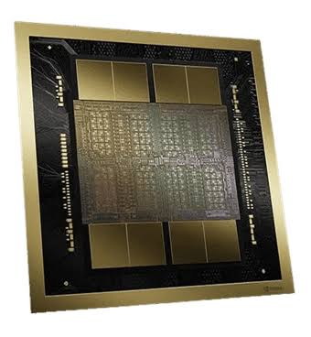
NVIDIA GPU Growth — More Transistors, More Parallel Work
NVIDIA historical transistor counts, 1995–2026 (linear vertical scale)
400
Graphics → Accelerated Computing → Artificial Intelligence
The Market Value of NVIDIA is $5.4B
It is worth more than Apple, Microsoft and about 2X the value of Amazon
350
336B
300
250
INVIDIA B300 Blackwell Ultra
$62,000 per GPU
Billion
transistors
208B
200
150
100
80B
54.2B
50
7.1B
15.3B
1M
22M
1.4B
0
1995
1999
2002
2005
2008
2010
2012
2016
2020
2022
2024
2026
1 million (NV1) → 80 billion (Hopper) → 208 billion (Blackwell) → 336 billion (Rubin)
Graphics → Accelerated Computing → Artificial Intelligence
Selected representative NVIDIA GPUs; recent counts: Hopper 80B, Blackwell 208B, Rubin 336B.

Slide 20
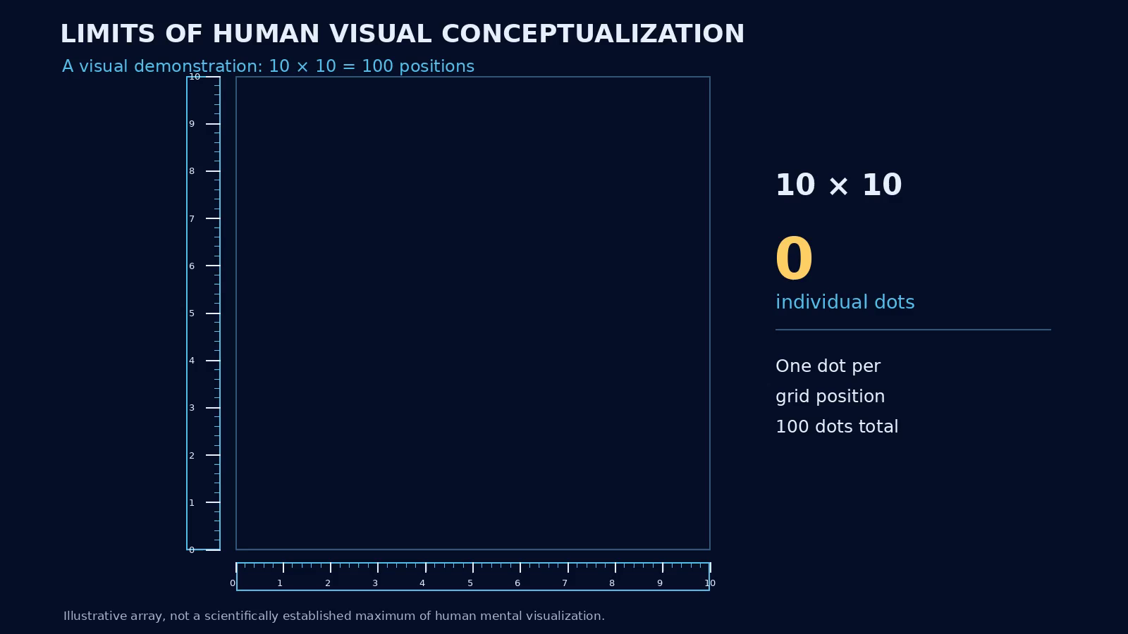
A 100 Point Demonstration of Human Visual Memory
Limits of Human
Neural Processing

Slide 21
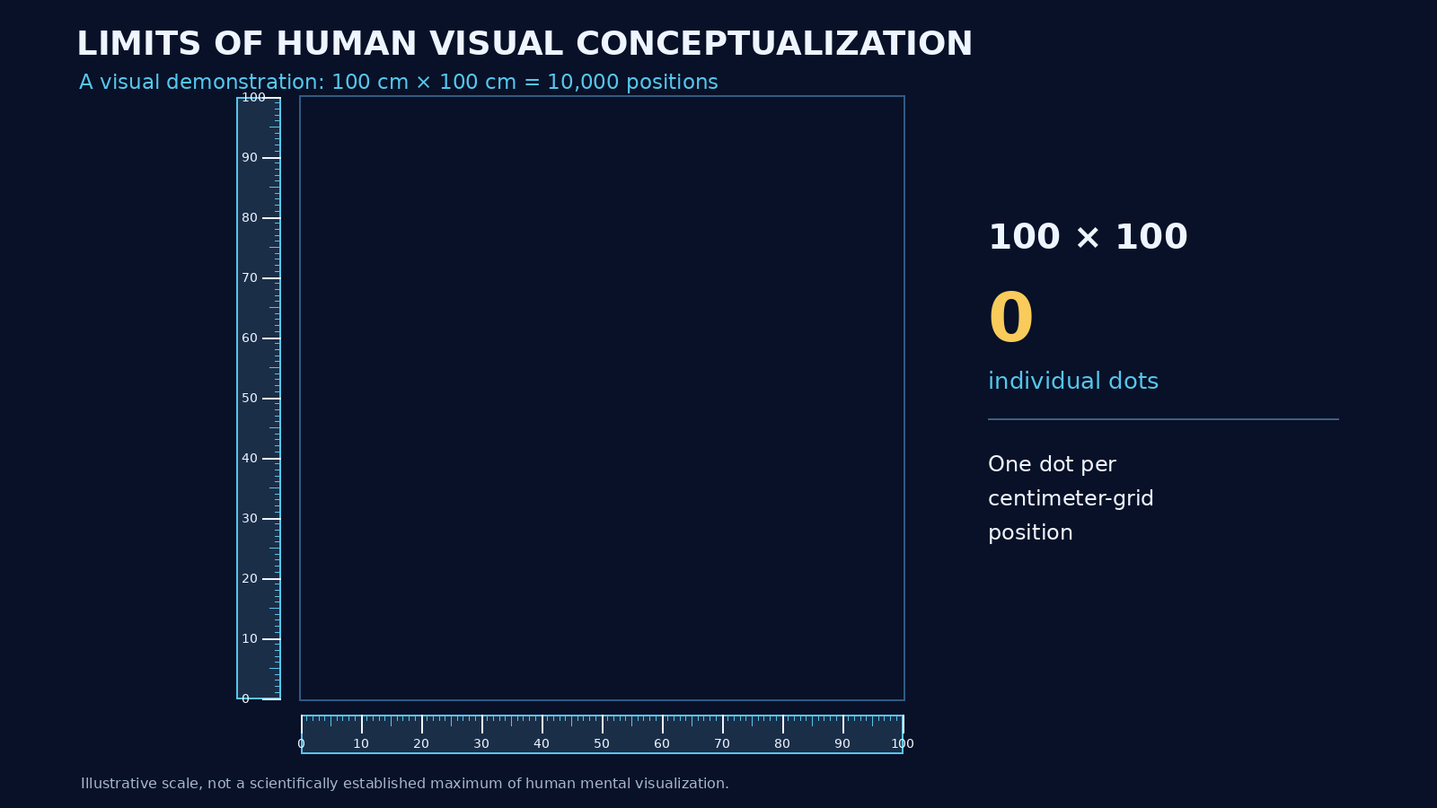

A 9,900 Point Demonstration of Human Visual Reconstruction
Limits of Human
Neural Processing
10,000 Positions — 100 Random Dots Missing
In comparison, a LLM can
handle about 400 million
Numerical coordinates.
About 40,000 times more
than humans.

Slide 22
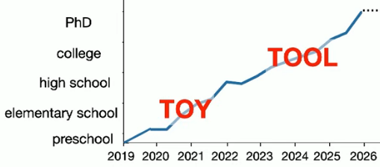
Strength of Large Language Models Today
Research Mathematics
GPQA: Graduate-Level Google-Proof Q&A Benchmark -----------
LLMs are low agency, slow learners,
poor at planning and error correction.
Intelligence: How capable is the system at
reasoning, predicting, solving and generating?
Agency: How independently can the system
pursue goals and take actions?

Slide 23
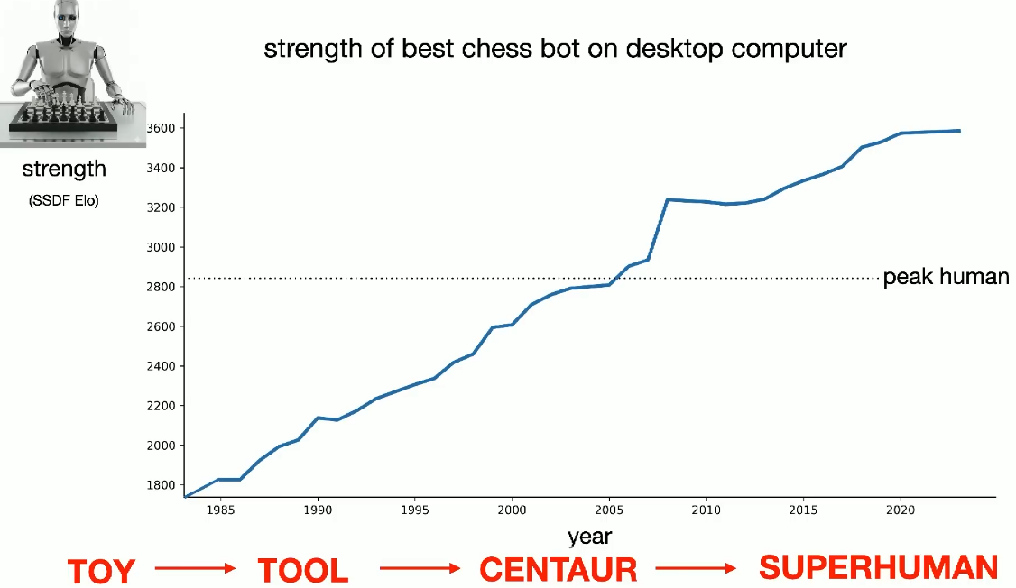

Strength of Large Language Models
Research Mathematics
1997 IBM Deep Blue
Defeats Boris Spassky
30 Years

Slide 24
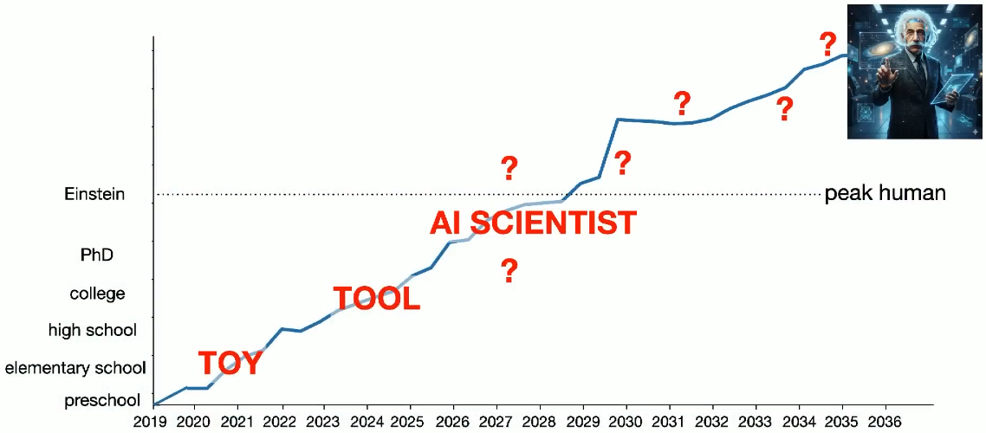
Strength of Large Language Models Tomorrow?
Research Mathematics
Research Mathematics
GPQA: Graduate-Level Google-Proof Q&A Benchmark -----------
New Renaissance in Science and Math
LLMs are low agency, slow learners,
poor at planning and error correction.
Some Mathematicians are in Despair
2026 Navier-Stokes Problem Controversy
~10,000 AI agents + enormous computation
+ human mathematical knowledge
→ attack a problem humans had not resolved in decades.
88 hours, 300 billion output tokens
Estimated Cost: $22,500,000 at current LLM rates
206
Intelligence: How capable is the system at
reasoning, predicting, solving and generating?
Agency: How independently can the system
pursue goals and take actions?

Slide 25
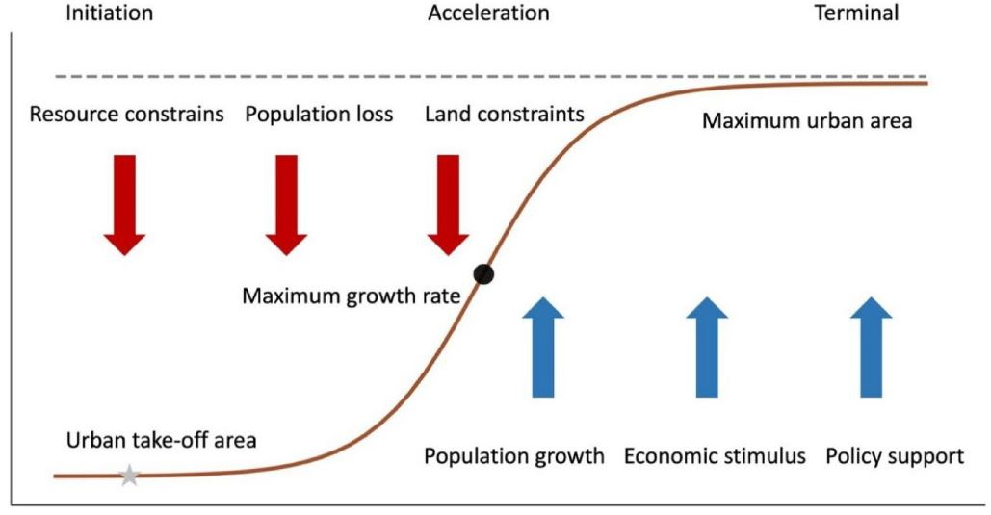
Urban Area Growth — A Sigmoidal Limit
Physical Limitations
of Growth
Initiation → Acceleration → Terminal saturation
Illustrative urban growth model • Physical limits can slow expansion toward a maximum area.

Slide 26
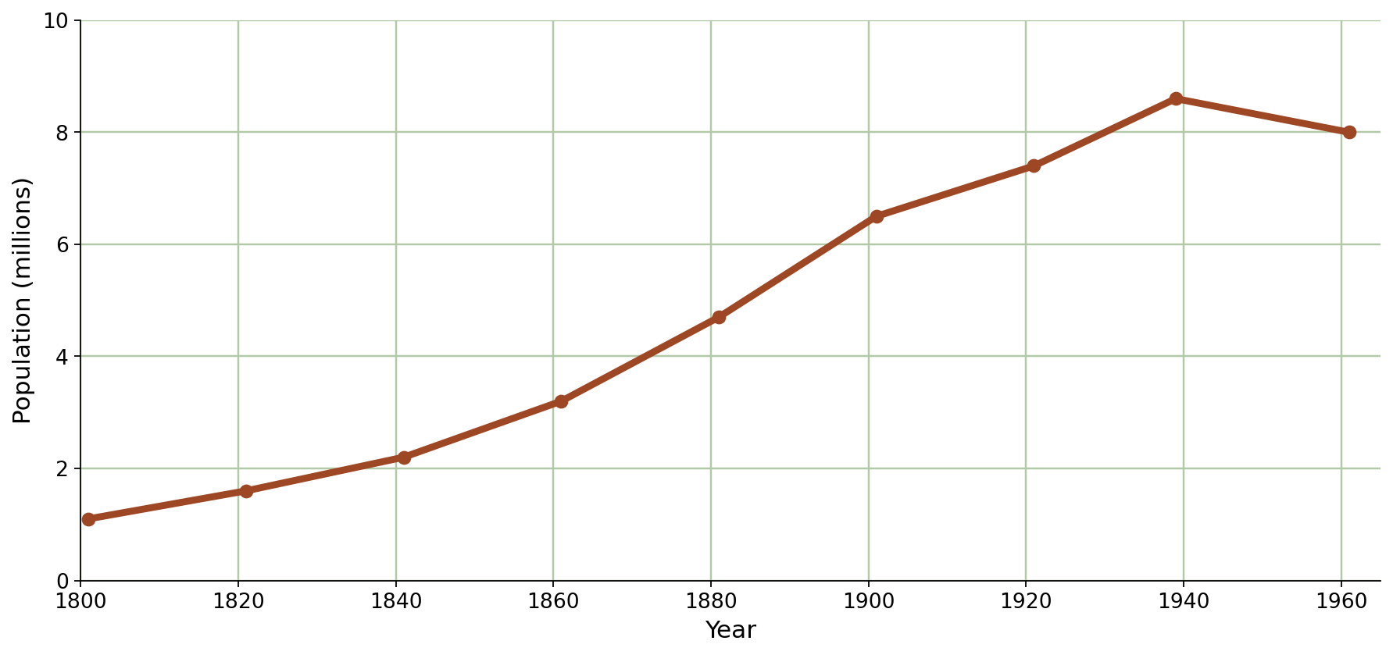
Physical Limitations
of Growth
London Population — Growth and Leveling Off
Historical city population provides a real-world comparison
Approximate historical population figures • Real urban growth is not a perfect logistic curve.

Slide 27
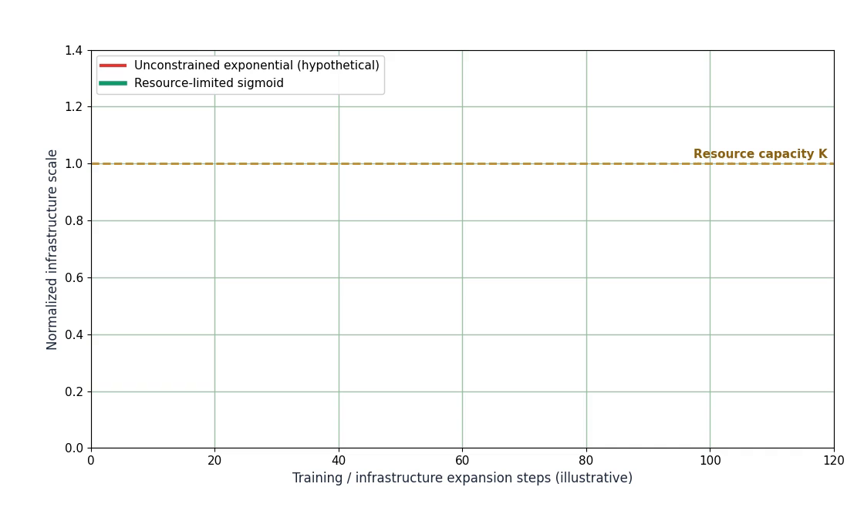
THE PHYSICAL LIMITS OF AI GROWTH
Exponential expansion meets finite resources
RESOURCE CONSTRAINTS
• ELECTRICAL POWER
• GDP & CAPITAL
• LAND & DATA CENTERS
• WATER & COOLING
• CHIPS & MATERIALS
Innovation can raise the carrying capacity; no single fixed ceiling on AI capability is implied.
Illustrative logistic model, not a forecast. Physical infrastructure faces constraints; capability may follow successive S-curves.

Slide 28
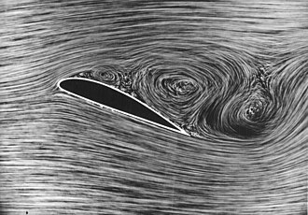
Visualization Reveals the Hidden Dynamics of Complex Systems.
Using a Wind Tunnel to observe the Dynamics of Airflow on an Aircraft Wing.

Slide 29

The
Concept of
Entropy

Slide 30
The
Concept of
Entropy

Slide 31
1. Low Entropy — Ordered Structure
The intact vase represents a highly organized state.
Intact vase:
low physical disorder
LLM analogy:
a concentrated, organized probability pattern
Entropy is best described here as uncertainty or disorder.
Low entropy = fewer plausible arrangements
Roadmap 6

Slide 32

2. High Entropy — Many Possibilities
When the vase shatters, the possible arrangements multiply.
Shattered pieces:
high disorder
LLM analogy:
many possible token outputs compete
Token-output entropy measures uncertainty in the output probabilities.
High entropy = many plausible choices
Roadmap 6

Slide 33
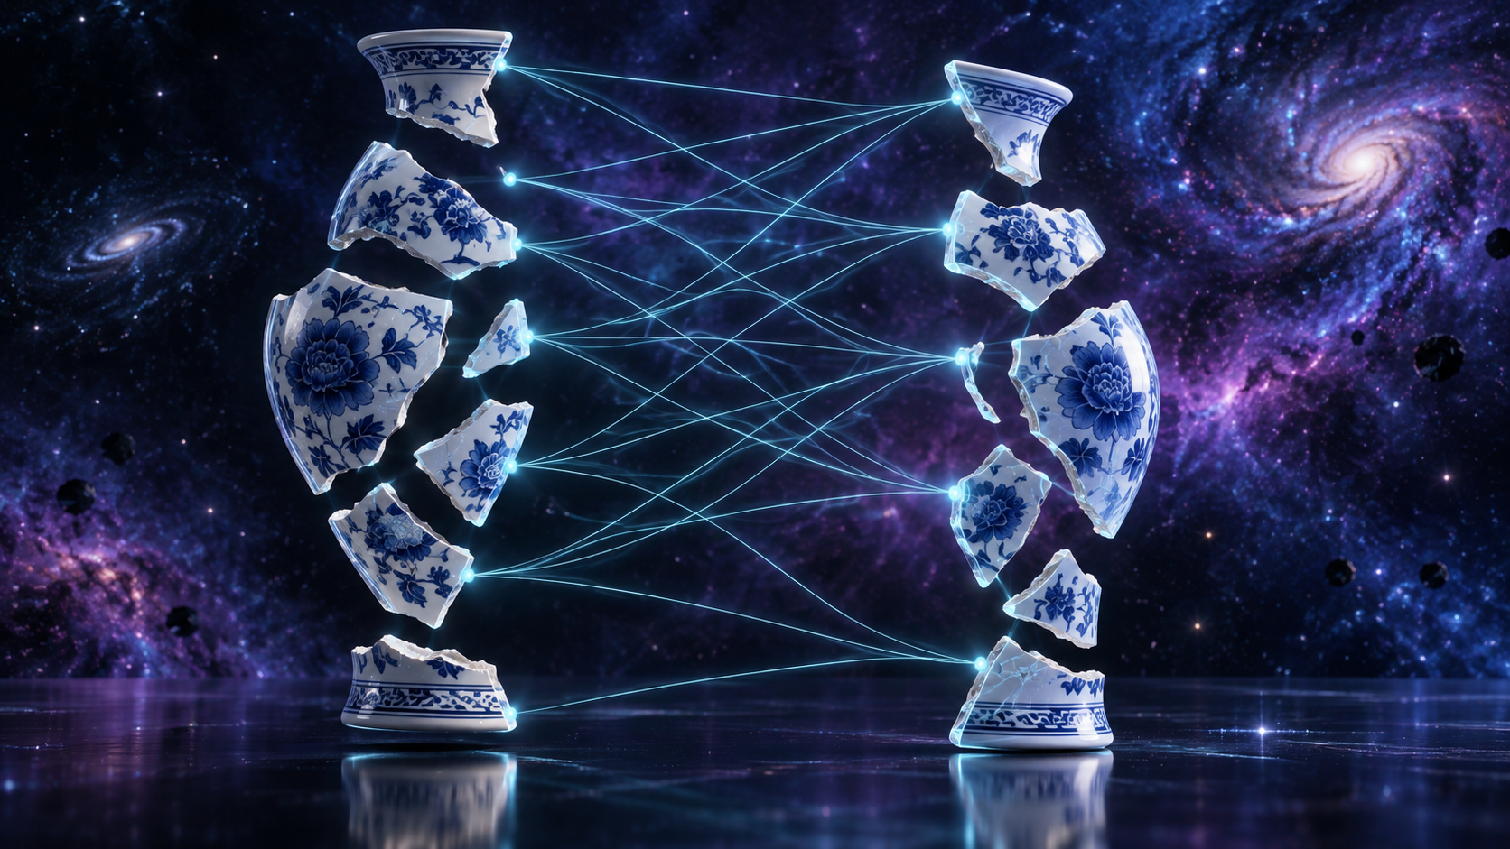
3. Attention — Compare Each Piece With Others
The system scores which pieces seem to fit together.
Piece-to-piece comparison
Transformer analogy:
Q compares with K
Softmax turns scores into relative attention weights.
QKᵀ → scores
Softmax → attention
Roadmap 6

Slide 34
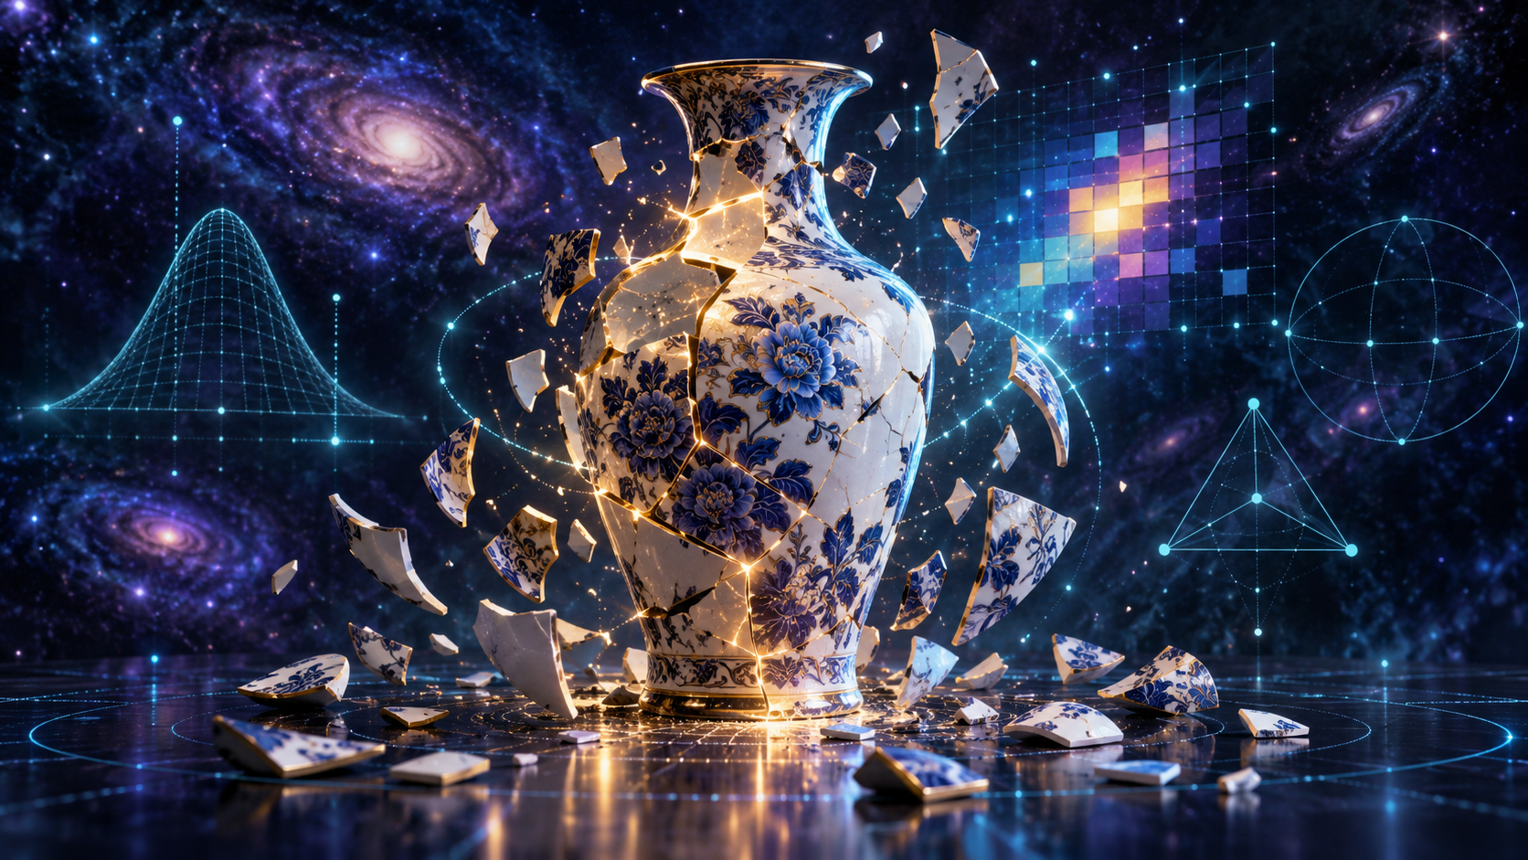
4. Learning — From Uncertainty to Structure
Training adjusts weights so useful relationships become stronger.
The vase begins to regain structure.
LLM analogy:
weights change so better relationships receive more attention.
Htrain falling means the output distribution is becoming more certain.
Loss ↓ Htrain ↓ Ptarget ↑
Roadmap 6

Slide 35
From a Broken Vase to Quantified Entropy
A teaching analogy connecting 1,000 unresolved possibilities to H = ln(N)
SHATTERED VASE
1,000 unresolved possibilities
H = ln(1000) = 6.91
REASSEMBLY / TRAINING
Each step eliminates possibilities
Structure increases
NEARLY RESOLVED
H ≈ 0.20
N effective = e^0.2 ≈ 1.22
→
→
The number of physical pieces is NOT the entropy.
For the illustration, the pieces represent equally plausible unresolved arrangements or possibilities.
N≈1,000
H=6.91
N≈403
H=6.0
N≈148
H=5.0
N≈55
H=4.0
N≈20
H=3.0
N≈7
H=2.0
N≈2.7
H=1.0
N≈≈1
H=0.2
N effective = eᴴ ⇄ H = ln(N effective)
GIF interpretation: Step 0 ≈ 1,000 possibilities → Step 100 ≈ one strongly preferred possibility
Illustrative vase-derived entropy mapping — not measured Python Htrain data.
Roadmap 6

Slide 36
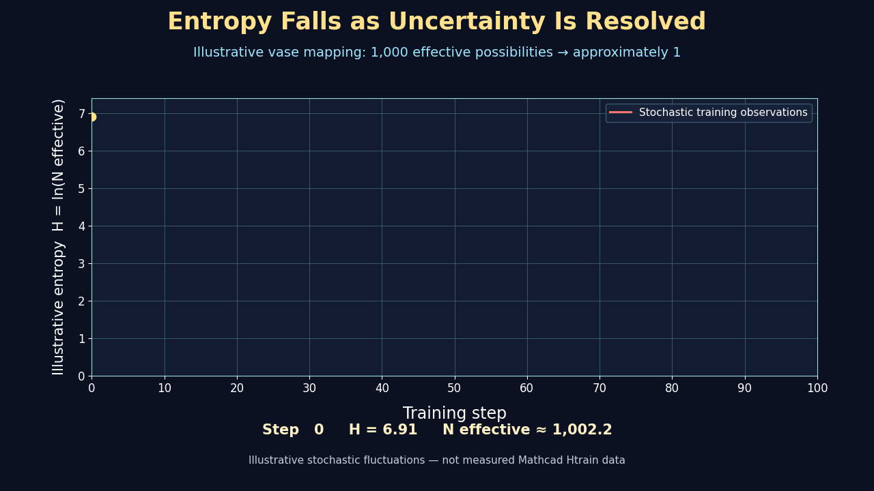

Slide 37
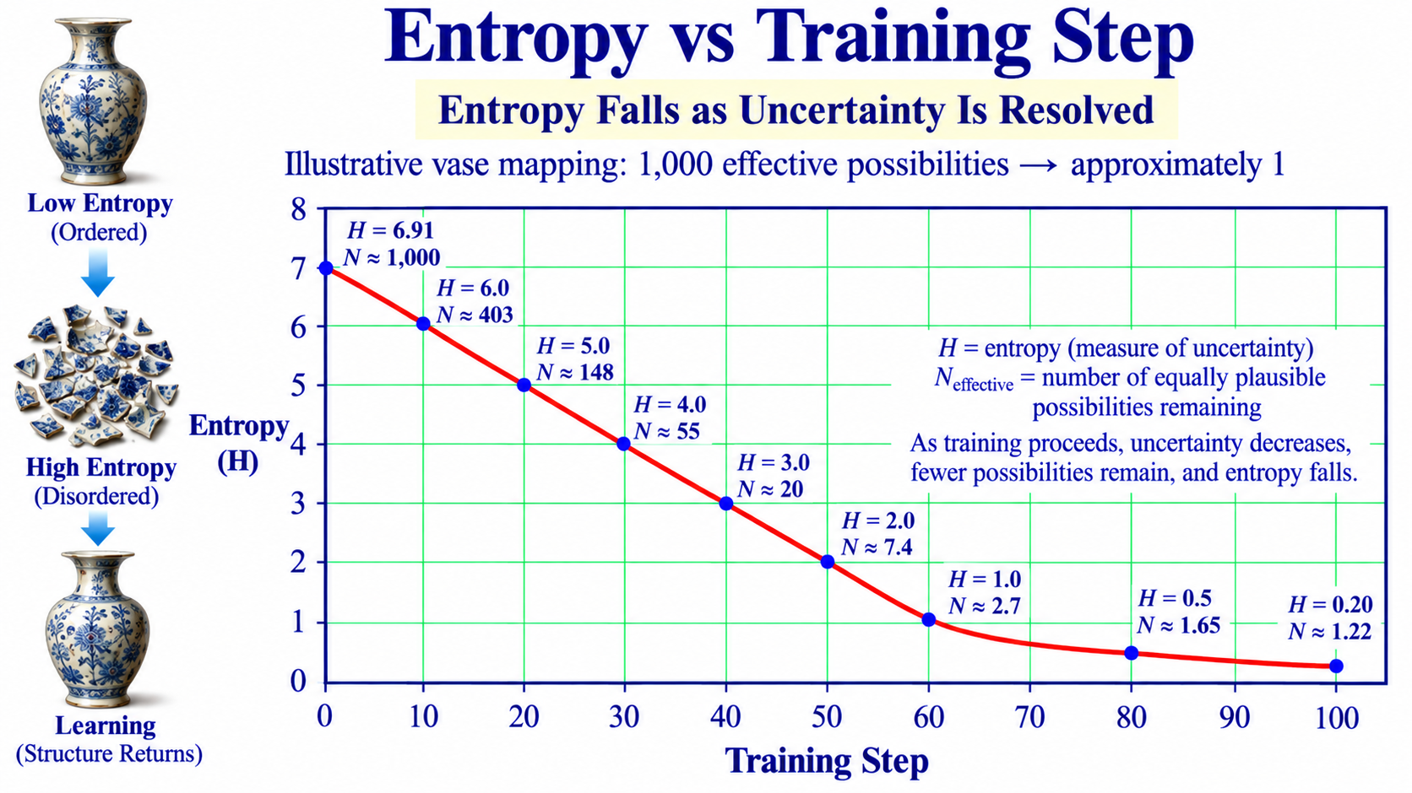
Roadmap 6

Slide 38
Physical Parameters of the Pieces from the Broken Vase
.
Color of Paint
Shape of Pieces
    (Round, etc.)
Material
Curvature
Size in mm
Thickness
Complexity
Beauty of Piece
Painted Objects
Crystallinity
Volume
Rotation
Density
Porosity
Hardness
Orientation
Defects
Moisture
Roughness
# of Neighbors
Symmetries
21 versus 400,000,000 Dimensions

Slide 39
History of Technology and Concepts: Leading to Artificial Intelligence
Date | Name / Development | Contribution to AI
1943 | Warren McCulloch & Walter Pitts | Created a mathematical model of an artificial neuron - a conceptual beginning of neural networks.
1948-51 | Claude Shannon | Developed information theory and, ENTROPY providing mathematics for measuring information and uncertainty.
1950 | Alan Turing | Proposed the Turing Test and framed the fundamental question of whether machines can exhibit intelligent behavior.
1956 | Dartmouth Workshop - John McCarthy et al. | Helped establish Artificial Intelligence as a named field of research.
1957-58 | Frank Rosenblatt - Perceptron | Developed an early learning neural network that adjusted weights from examples.
1966 | Joseph Weizenbaum – ELIZA | Demonstrated computer conversation using Natural-Language RULE BASED pattern matching.
1972 | Atari - Pong | Helped launch interactive video gaming and demand for increasingly capable real-time graphics hardware.
1978 | Apple II Computer – Eliza Program in Basic | About 120 lines of Basic Language Code for a Chat type program.
1980 | Pac-Man | Illustrates increasingly sophisticated real-time digital graphics represented and manipulated numerically as pixels.
1986 | Rumelhart, Hinton - Backpropagation | Popularized an effective method for training multilayer neural networks by propagating errors backward.
1990s | 3-D Video Games / PlayStation | Rapidly increased demand for specialized parallel graphics computation.
1999 | NVIDIA - GeForce 256 GPU | Popularized the GPU concept as a highly parallel processor for graphics calculations.
2006 | NVIDIA – CUDA GPU Programming Language | Made GPU parallel processing accessible for general scientific and numerical computation.
2012 | Krizhevsky, Sutskever & Hinton - AlexNet | Demonstrated the power of deep neural networks trained with GPUs for image recognition.
2013 | Tomas Mikolov et al. - Word2Vec | Represented words as learned multidimensional vectors in which semantic relationships emerge.
2014 | Bahdanau, Cho & Bengio - Attention | Introduced a practical neural attention mechanism that lets models emphasize relevant parts of an input.
2015 | Sennrich,- BPE for Neural Machine Translation | Applied subword tokenization to neural machine translation, helping models handle large vocabularies and rare words.

Slide 40
1966 — ELIZA: A Machine Appears to Converse –Transistor Technology
A Rule-Based Conversation — decades before the Large Language Models, LLM
MIT ARTIFICIAL INTELLIGENCE LABORATORY // ELIZA
ELIZA:
HOW DO YOU DO. PLEASE TELL ME YOUR PROBLEM.
CLICK → reveal the next exchange

Slide 41
1966 — ELIZA: A Machine Appears to Converse
A rule-based conversation — decades before the Transformer
MIT ARTIFICIAL INTELLIGENCE LABORATORY // ELIZA
ELIZA:
HOW DO YOU DO. PLEASE TELL ME YOUR PROBLEM.
YOU:
I AM WORRIED ABOUT ARTIFICIAL INTELLIGENCE.
CLICK → reveal the next exchange

Slide 42
1966 — ELIZA: A Machine Appears to Converse
A rule-based conversation — decades before the Transformer
MIT ARTIFICIAL INTELLIGENCE LABORATORY // ELIZA
ELIZA:
HOW DO YOU DO. PLEASE TELL ME YOUR PROBLEM.
YOU:
I AM WORRIED ABOUT ARTIFICIAL INTELLIGENCE.
ELIZA:
WHY ARE YOU WORRIED ABOUT ARTIFICIAL INTELLIGENCE?
CLICK → reveal the next exchange

Slide 43
1966 — ELIZA: A Machine Appears to Converse
A rule-based conversation — decades before the Transformer
MIT ARTIFICIAL INTELLIGENCE LABORATORY // ELIZA
ELIZA:
HOW DO YOU DO. PLEASE TELL ME YOUR PROBLEM.
YOU:
I AM WORRIED ABOUT ARTIFICIAL INTELLIGENCE.
ELIZA:
WHY ARE YOU WORRIED ABOUT ARTIFICIAL INTELLIGENCE?
YOU:
BECAUSE COMPUTERS ARE BECOMING VERY INTELLIGENT.
CLICK → reveal the next exchange

Slide 44
1966 — ELIZA: A Machine Appears to Converse
A rule-based conversation — decades before the Transformer
MIT ARTIFICIAL INTELLIGENCE LABORATORY // ELIZA
ELIZA:
HOW DO YOU DO. PLEASE TELL ME YOUR PROBLEM.
YOU:
I AM WORRIED ABOUT ARTIFICIAL INTELLIGENCE.
ELIZA:
WHY ARE YOU WORRIED ABOUT ARTIFICIAL INTELLIGENCE?
YOU:
BECAUSE COMPUTERS ARE BECOMING VERY INTELLIGENT.
ELIZA:
DO COMPUTERS CONCERN YOU?
CLICK → reveal the next exchange

Slide 45
1966 — ELIZA: A Machine Appears to Converse
A rule-based conversation — decades before the Transformer
MIT ARTIFICIAL INTELLIGENCE LABORATORY // ELIZA
ELIZA:
HOW DO YOU DO. PLEASE TELL ME YOUR PROBLEM.
YOU:
I AM WORRIED ABOUT ARTIFICIAL INTELLIGENCE.
ELIZA:
WHY ARE YOU WORRIED ABOUT ARTIFICIAL INTELLIGENCE?
YOU:
BECAUSE COMPUTERS ARE BECOMING VERY INTELLIGENT.
ELIZA:
DO COMPUTERS CONCERN YOU?
YOU:
SOMETIMES I THINK THEY UNDERSTAND ME.
CLICK → reveal the next exchange

Slide 46
1966 — ELIZA: A Machine Appears to Converse
A rule-based conversation — decades before the Transformer
MIT ARTIFICIAL INTELLIGENCE LABORATORY // ELIZA
ELIZA:
HOW DO YOU DO. PLEASE TELL ME YOUR PROBLEM.
YOU:
I AM WORRIED ABOUT ARTIFICIAL INTELLIGENCE.
ELIZA:
WHY ARE YOU WORRIED ABOUT ARTIFICIAL INTELLIGENCE?
YOU:
BECAUSE COMPUTERS ARE BECOMING VERY INTELLIGENT.
ELIZA:
DO COMPUTERS CONCERN YOU?
YOU:
SOMETIMES I THINK THEY UNDERSTAND ME.
ELIZA:
WHY DO YOU THINK THEY UNDERSTAND YOU?
CLICK → reveal the next exchange

Slide 47
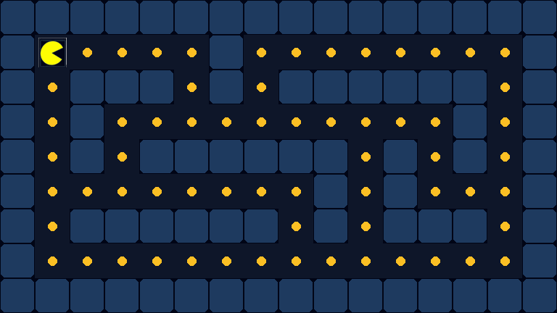
1980 Foundational Use for GPU Graphics - GAMES: Pizza-Man Animation -MicroProcessor

Slide 48
Neural Networks
and
Learning

Slide 49

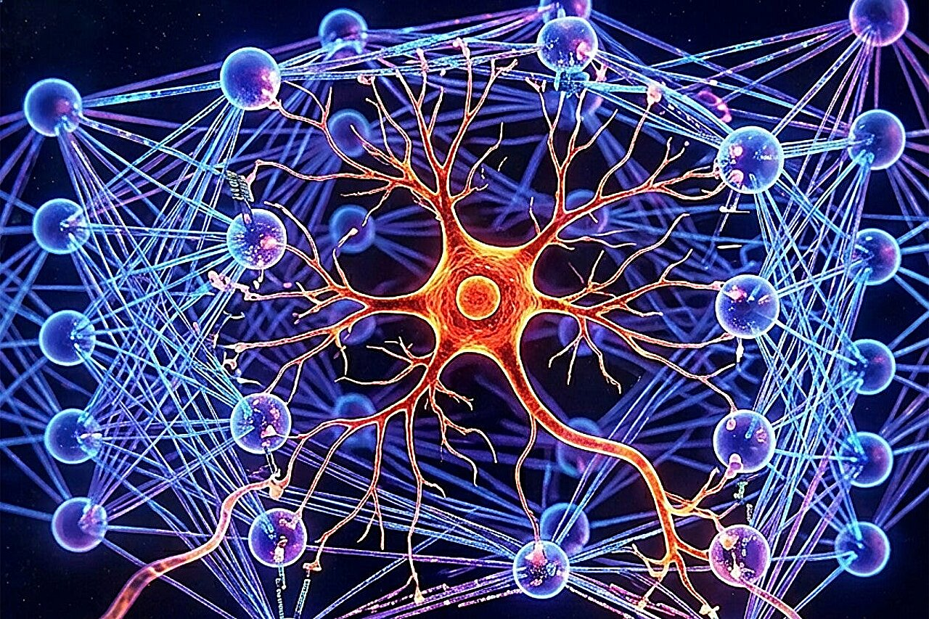
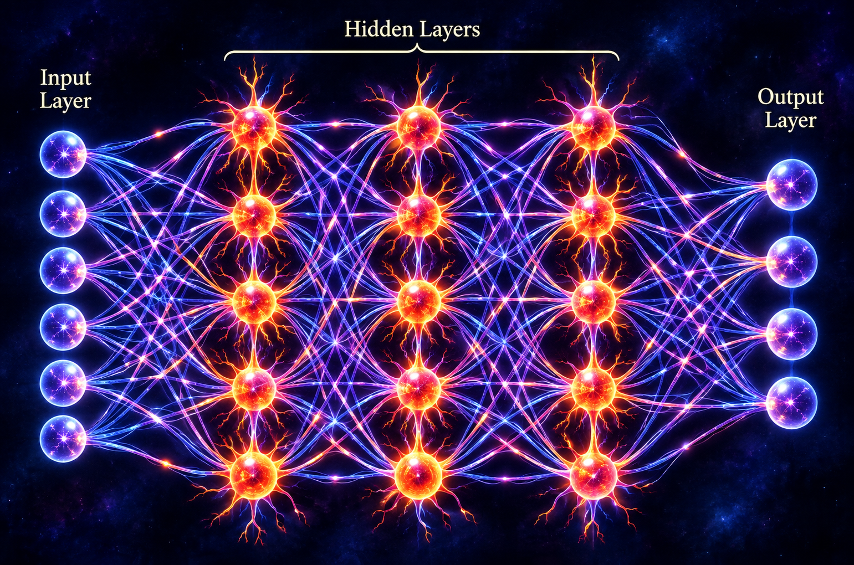
ℕeuron – ℕeural ℕetwork
We have 100 billion nerve cells firing in our brain, and
each one of them has 10,000 connections to other neurons.
Computational model of a Neuron
Neuronal activity is divided into three pieces:
simple interactions between one input and one output;
complex interactions involving multiple inputs; and
"latent noise," which arises from the inherent randomness of synapses and reaction spikes.

Slide 50
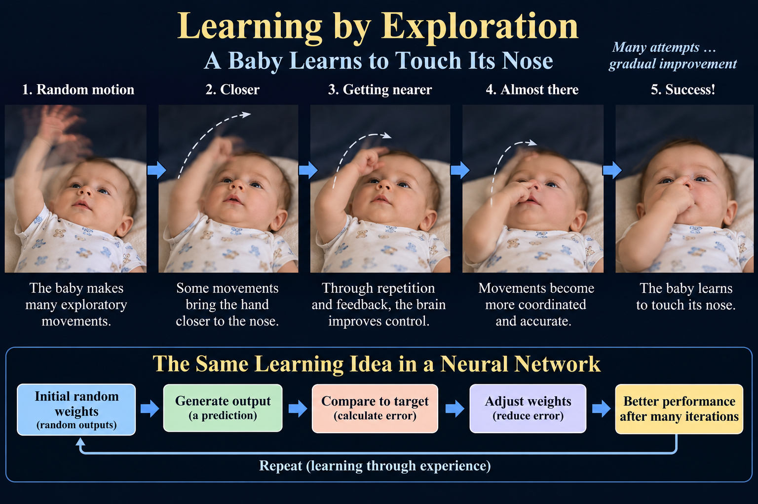

Slide 51
Feedback Changes the Brain
Experience helps refine the relationship between motor commands and movement
1
2
3
4
Motor command
➜
Movement
➜
Sensory feedback
➜
Adaptation
Brain sends a movement signal
Hand moves toward a target
Vision and touch report the result
Neural circuits gradually refine control
Repeat the cycle → increasingly coordinated movement
VISUALIZING THE DYNAMICS OF ARTIFICIAL INTELLIGENCE
2

Slide 52
From Exploratory Movement to Neural-Network Training
A useful analogy—without claiming biological and artificial learning are identical
DEVELOPING MOTOR CONTROL
ARTIFICIAL NEURAL NETWORK
Exploratory movement
Initial prediction
Sensory feedback
Calculated loss
Neural adaptation
Weight update
Improved coordination
Improved prediction
Shared principle: feedback changes future behavior.
VISUALIZING THE DYNAMICS OF ARTIFICIAL INTELLIGENCE
4

Slide 53
A Neural Network Learns Through Repeated Updates
The computer measures prediction error and adjusts its weights
Input
Prediction
Loss
Update
➜
➜
➜
Training example
Network output
Measure the error
Adjust weights
Illustrative training loss
Repeated training steps →
Error is diminished
Unlike a baby, backpropagation computes mathematical gradients.
VISUALIZING THE DYNAMICS OF ARTIFICIAL INTELLIGENCE
3

Slide 54
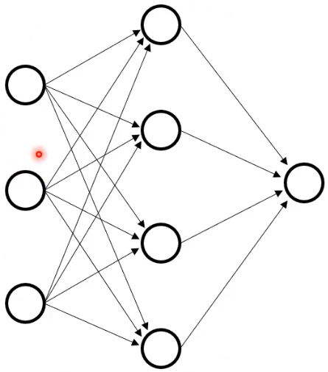
Building a Perceptron — Step by Step
Neural Network
Neural Network
Neural Network
1957
Technology: Vacuum-tube/electronic and relay-era components
were part of the broader implementation technology;
this was before semiconductor IC-based neural-network hardware.

Slide 55
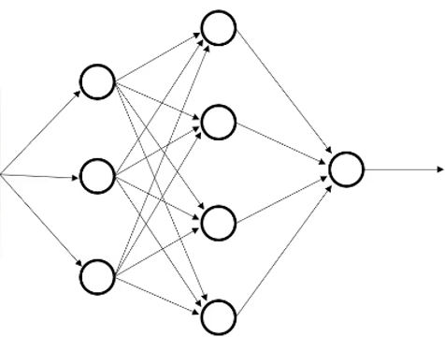

Early Use of Neural Networks
For Simple Pattern Recognition
Probability:
85% Dog

Slide 56
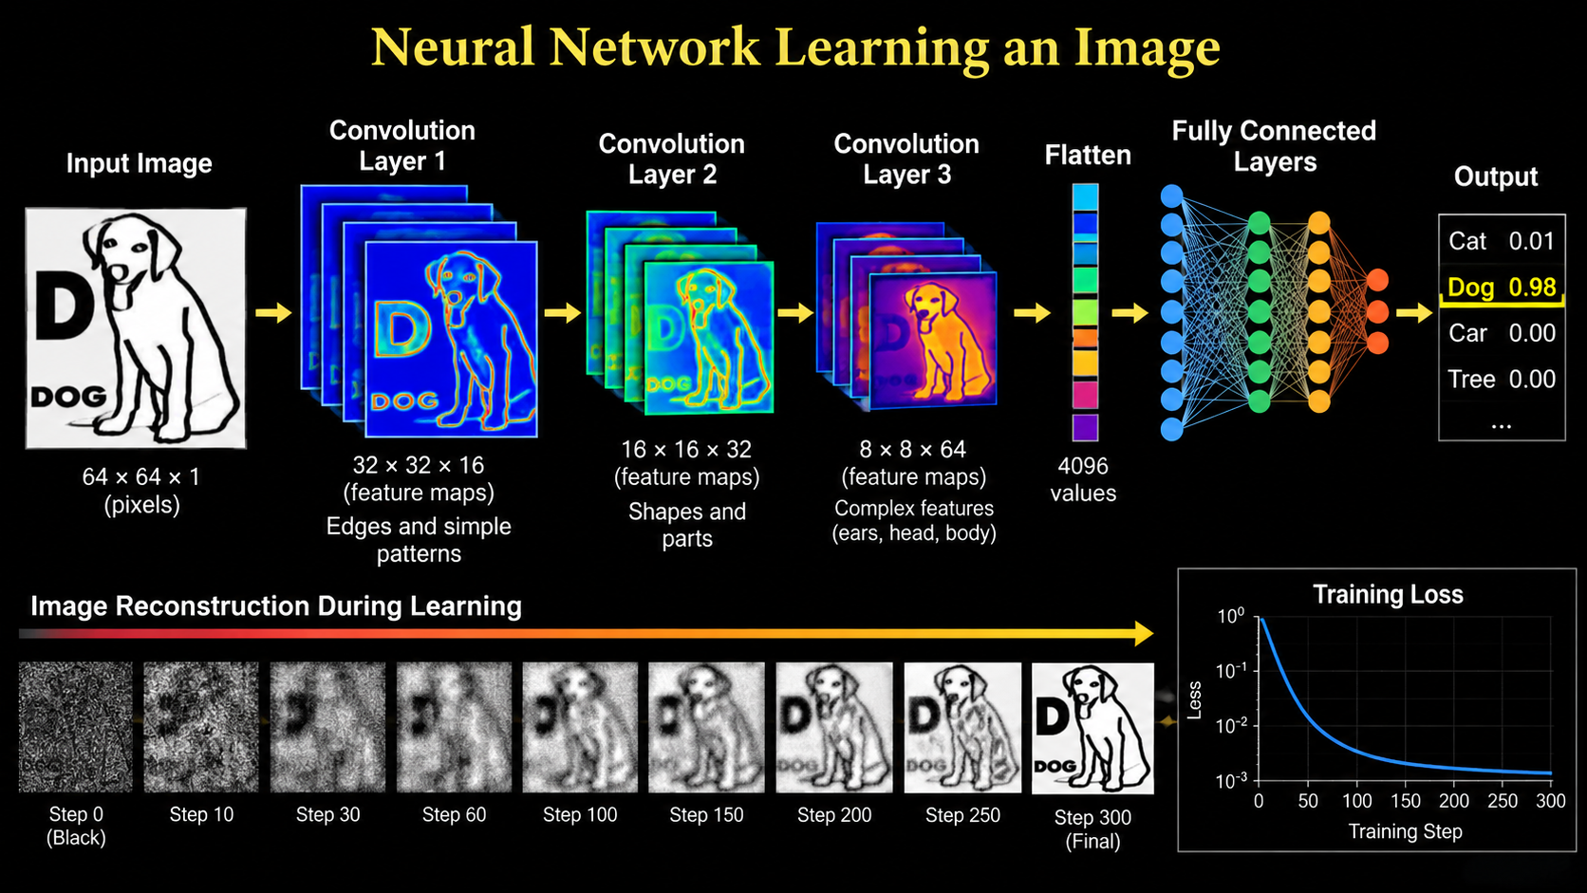

Slide 57
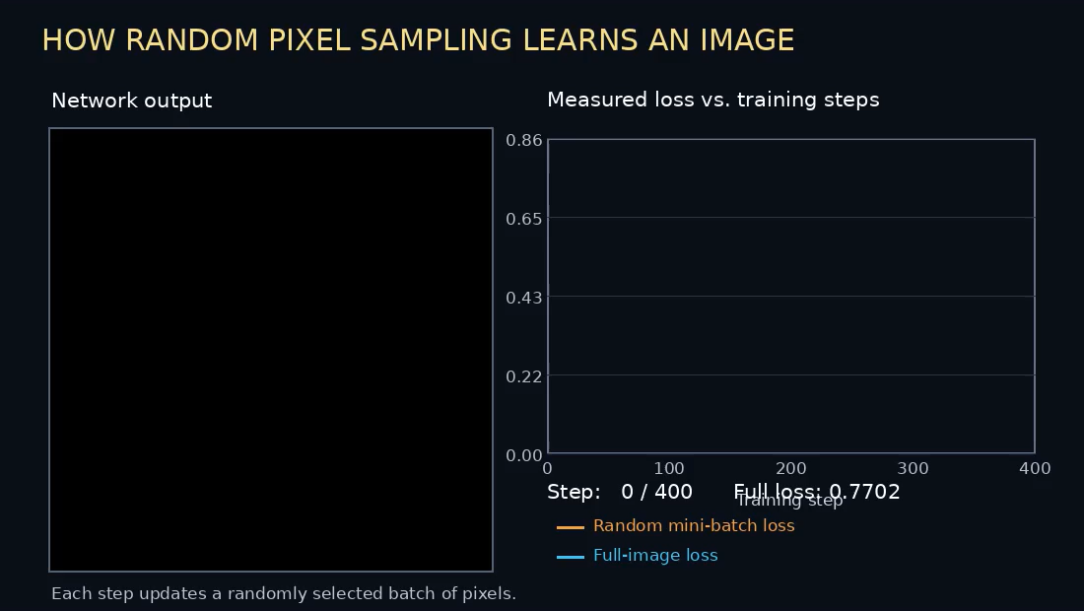

Slide 58
History of Technology and Concepts: Leading to Artificial Intelligence
Date | Name / Development | Contribution to AI
1943 | Warren McCulloch & Walter Pitts | Created a mathematical model of an artificial neuron - a conceptual beginning of neural networks.
1948-51 | Claude Shannon | Developed information theory and, entropy providing mathematics for measuring information and uncertainty.
1950 | Alan Turing | Proposed the Turing Test and framed the fundamental question of whether machines can exhibit intelligent behavior.
1956 | Dartmouth Workshop - John McCarthy et al. | Helped establish Artificial Intelligence as a named field of research.
1957-58 | Frank Rosenblatt - Perceptron | Developed an early learning neural network that adjusted weights from examples.
1966 | Joseph Weizenbaum – ELIZA | Demonstrated computer conversation using natural-language RULE BASED pattern matching.
1972 | Atari - Pong | Helped launch interactive video gaming and demand for increasingly capable real-time graphics hardware.
1978 | Apple II Computer – Eliza Program in Basic | About 120 lines of Basic Language Code for a Chat type program.
1980 | Pac-Man | Illustrates increasingly sophisticated real-time digital graphics represented and manipulated numerically as pixels.
1986 | Rumelhart, Hinton - Backpropagation | Popularized an effective method for training multilayer neural networks by propagating errors backward.
1990s | 3-D Video Games / PlayStation | Rapidly increased demand for specialized parallel graphics computation.
1999 | NVIDIA - GeForce 256 GPU | Popularized the GPU concept as a highly parallel processor for graphics calculations.
2006 | NVIDIA – CUDA GPU Programming Language | Made GPU parallel processing accessible for general scientific and numerical computation.
2012 | Krizhevsky, Sutskever & Hinton - AlexNet | Demonstrated the power of deep neural networks trained with GPUs for image recognition.
2013 | Tomas Mikolov et al. - Word2Vec | Represented words as learned multidimensional vectors in which semantic relationships emerge.
2014 | Bahdanau, Cho & Bengio - Attention | Introduced a practical neural attention mechanism that lets models emphasize relevant parts of an input.
2015 | Sennrich,- BPE for Neural Machine Translation | Applied subword tokenization to neural machine translation, helping models handle large vocabularies and rare words.
2017 | Vaswani et al. – Attention is All you Need: Transformer | Made self-attention central, enabling highly parallel processing of language sequences.
2018 | OpenAI - GPT-1 | Demonstrated generative pretraining followed by task-specific adaptation using a Transformer.
2019 | OpenAI - GPT-2 | Showed that scaling Transformer language models substantially improved coherent text generation.
2020 | OpenAI - GPT-3 | Demonstrated strong few-shot and in-context learning at 175 billion parameters.
2026 | ChatGPT GPT-6 | Brought conversational large-language-model interaction into widespread public use.
2020s | AI GPU Data Centers | Thousands of accelerators working in parallel make training and serving today's large AI systems practical.

Slide 59
GPT - The Transformer

Slide 60
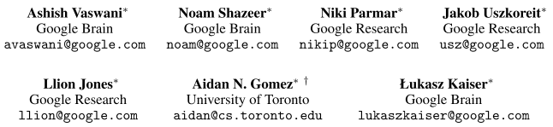
Large Language Models
Attention Is All You Need
"Attention Is All You Need"
is a 2017 research paper on machine learning authored by eight scientists and engineers working at Google. It is one of the most heavily cited academic papers in the history of computer science and artificial intelligence.
The paper introduced the Transformer architecture, which replaced slow sequential processing with self-attention mechanisms.
Why It Matters
Foundation of Modern AI: It is the underlying technology powering large language models like ChatGPT, Claude, and Gemini.
Industry Shift: By enabling parallelized training, it made large-scale machine learning vastly faster and more efficient, rendering older recurrent neural networks largely obsolete
The dominant sequence transduction models are based on complex recurrent or
convolutional neural networks that include an encoder and a decoder. The best
performing models also connect the encoder and decoder through an attention
mechanism. We propose a new simple network architecture, the Transformer,
based solely on attention mechanisms, dispensing with recurrence and convolutions entirely. Experiments on two machine translation tasks show these models to be superior in quality while being more parallelizable and requiring significantly less time to train. Our model achieves 28.4 BLEU on the WMT 2014 English-to-German translation task, improving over the existing best results, including ensembles, by over 2 BLEU. On the WMT 2014 English-to-French translation task, our model establishes a new single-model state-of-the-art BLEU score of 41.8 after training for 3.5 days on eight GPUs, a small fraction of the training costs of the best models from the literature. We show that the Transformer generalizes well to other tasks by applying it successfully to English constituency parsing both with large and limited training data.
BLEU stands for Bilingual Evaluation Understudy.

Slide 61
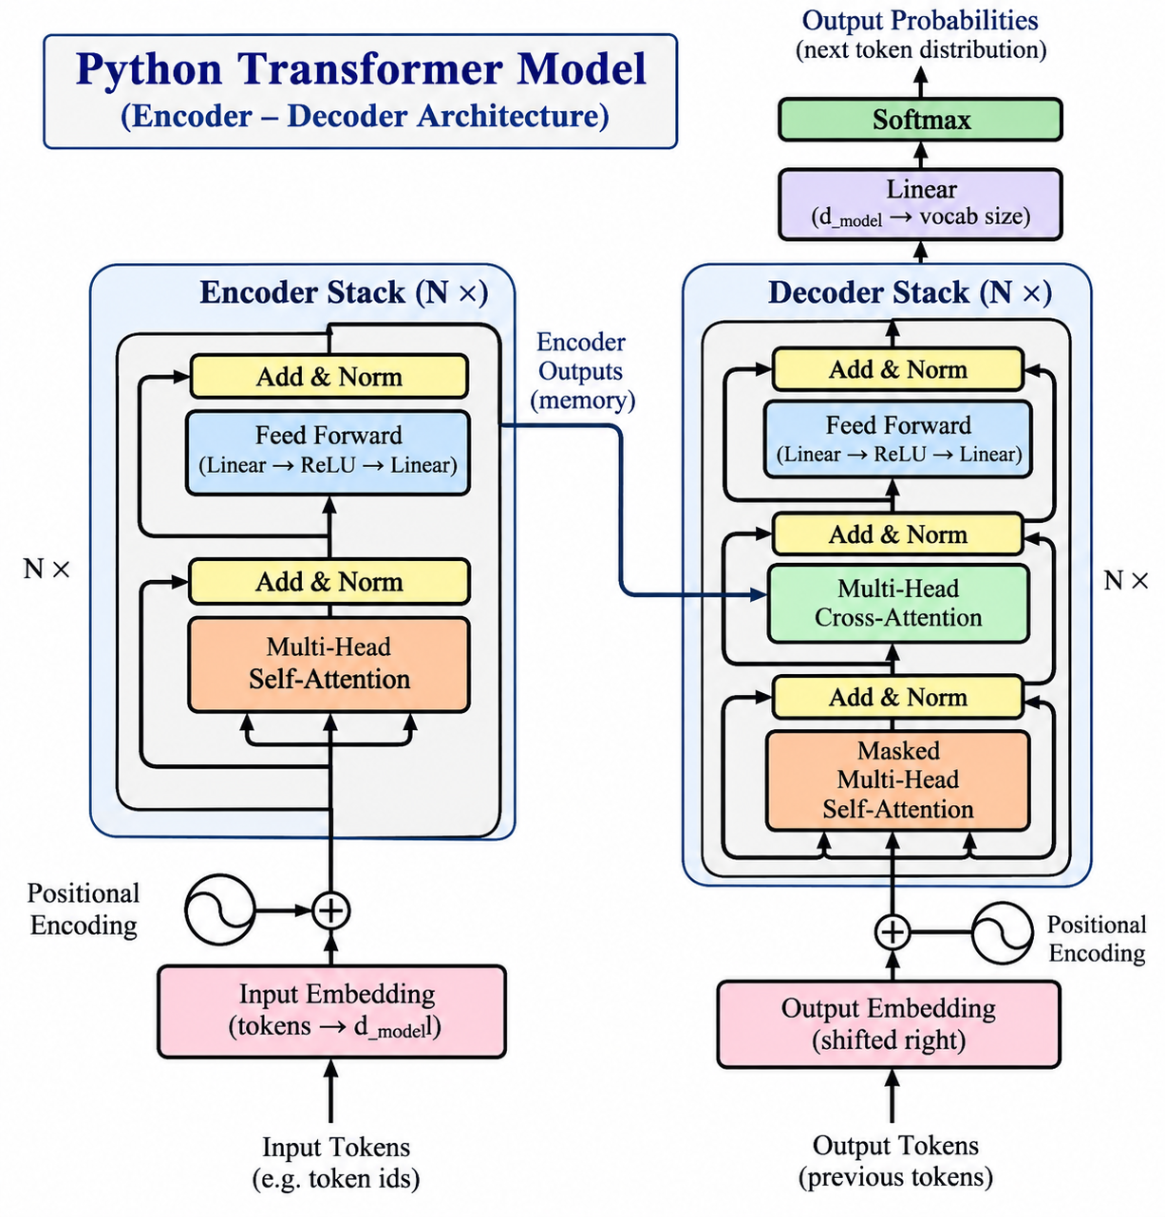
Transformer Model
Attention is all you Need
(Encoder – Decoder Arrchitecture)

Slide 62
How a Large Language Model Works
A simplified physical model of a transformer
1. Text
2. Tokens
3. Embeddings
4. Attention
5. Neural Network
6. Output
“The quick
brown fox…”
Words become
numbers
Numbers become
vectors
Tokens exchange
information
Transforms
representations
Predicts the
next token
Repeat this process to generate each additional token
Physical implementation: billions of calculations on GPUs, using electrical power, memory, and data-center infrastructure.

Slide 63
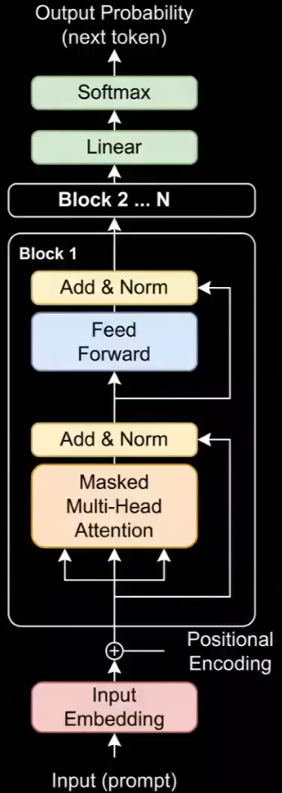

Operation of a Transformer
Visualizing the Dynamics of Artificial Intelligence
Tell me a story:
Once upon a time ….
Once upon a

Slide 64
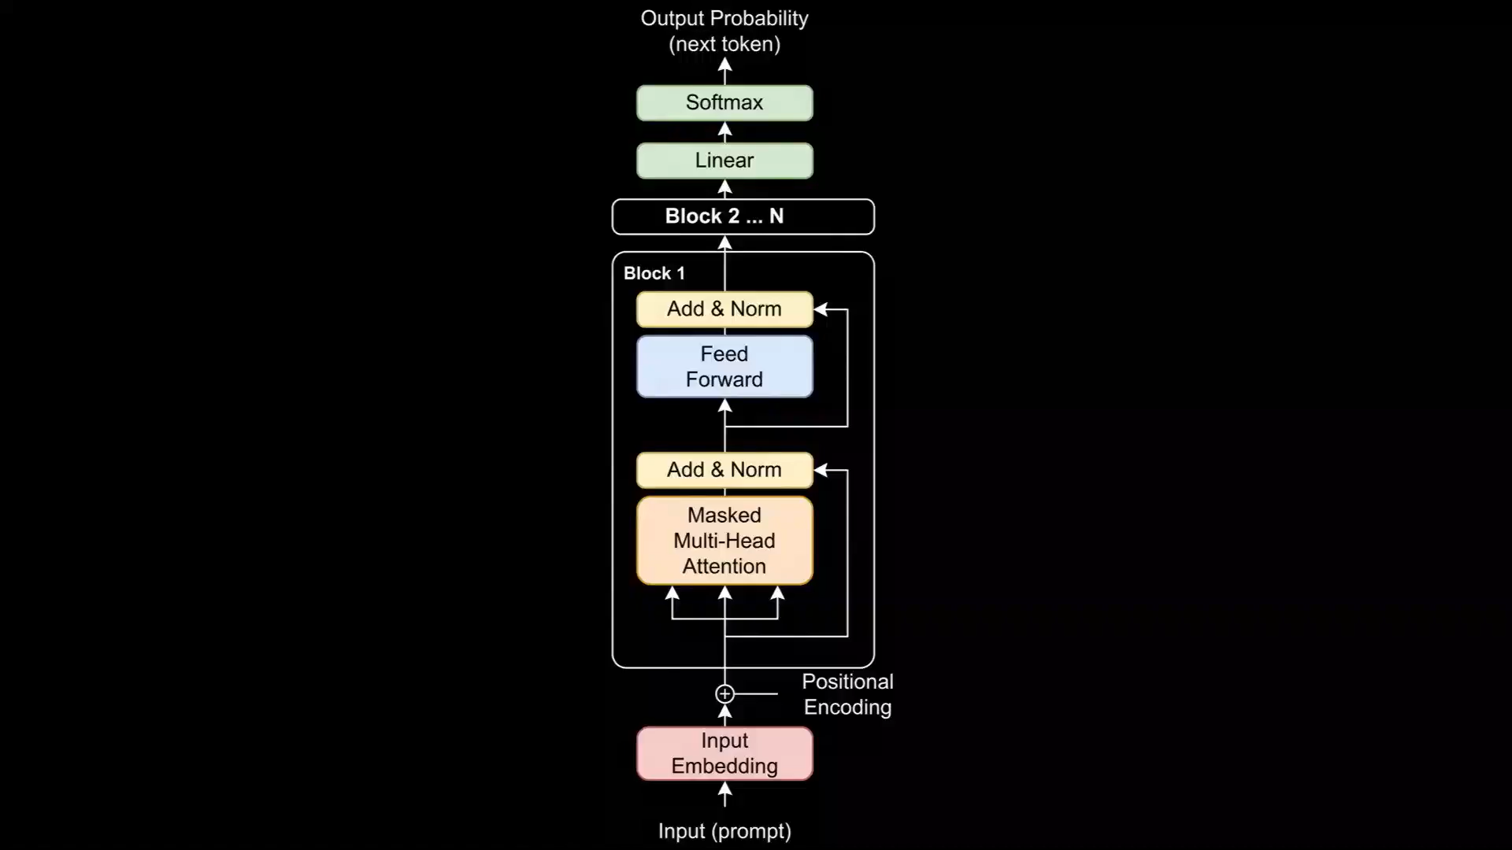

Slide 65
FROM A VECTOR TO A MATRIX
A simple visual bridge to understanding why Transformers fit GPUs so well
z
VECTOR (Word)
MATRIX (Sentence)
One ordered list of numbers
Many vectors arranged together
0.2
Example of a Vector →
.2
−.7
1.1
.4
−0.7
.8
.1
−.3
.9
ONE → MANY
1.1
−.2
.6
.5
1.0
0.4
.7
−.4
.2
.3
0.9
Think: ONE word represented numerically
Think: MANY words processed together
The above matrix is simply a rectangular grid of numbers, like a set of pigeonholes.
Each pigeonhole contains a number, identified by its row and column.
That shift—from one-at-a-time to many-at-once—is the bridge to Transformer parallelism.

Slide 66
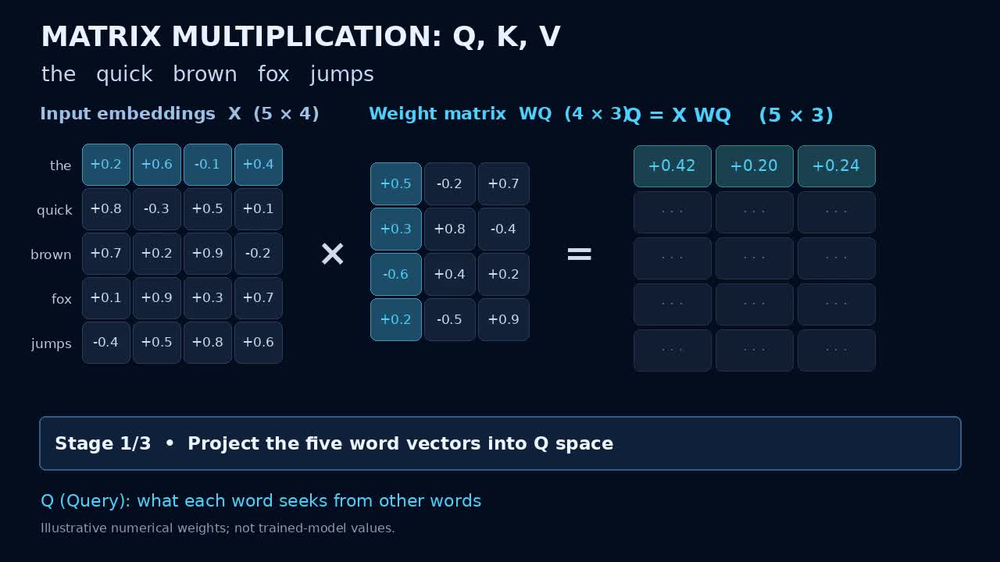

Slide 67
OLD LANGUAGE-MODEL ARCHITECTURE Limitations
RNNs and LSTMs carried information forward one step at a time
Distance Embedded Words lose
their relationship e.g. dog to jumps.
the →
quick →
brown →
fox →
jumps →
over →
the →
lazy →
dog
Each word waits for information from the previous step.
Example: People sitting in a row and trying to communicate further down the row.
Word → hidden state → next word → hidden state → next word …
LIMITATION
Long-distance relationships must travel through the chain,
and training is difficult to parallelize.

Slide 68
THE TRANSFORMER CHANGED THE ARCHITECTURE
Self-attention lets every token compare with other relevant tokens
the
quick
brown
fox
jumps
over
the
lazy
dog
SELF-ATTENTION
Compare many token relationships together
The sentence becomes matrices of Q, K and V vectors.
Matrix operations calculate many relationships simultaneously during training.
This is the architectural change that made massive parallel GPU computation especially useful.
Modern AI emerged when powerful parallel hardware met an architecture designed to exploit it.

Slide 69
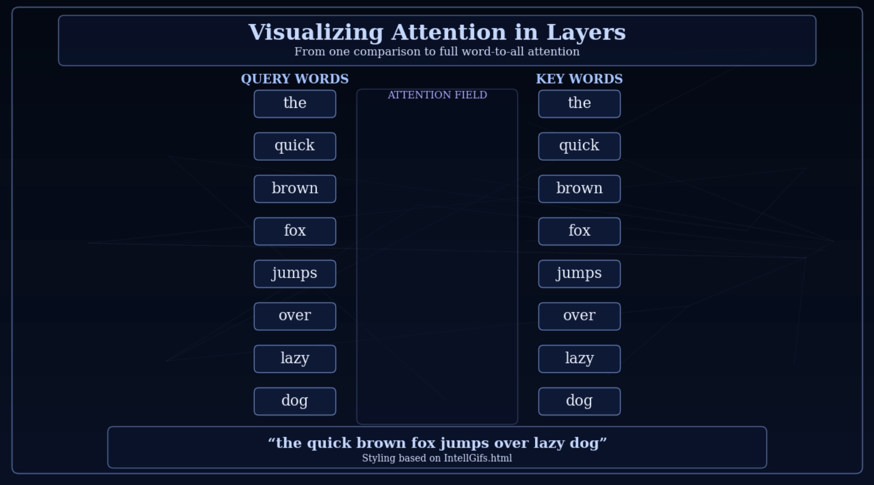
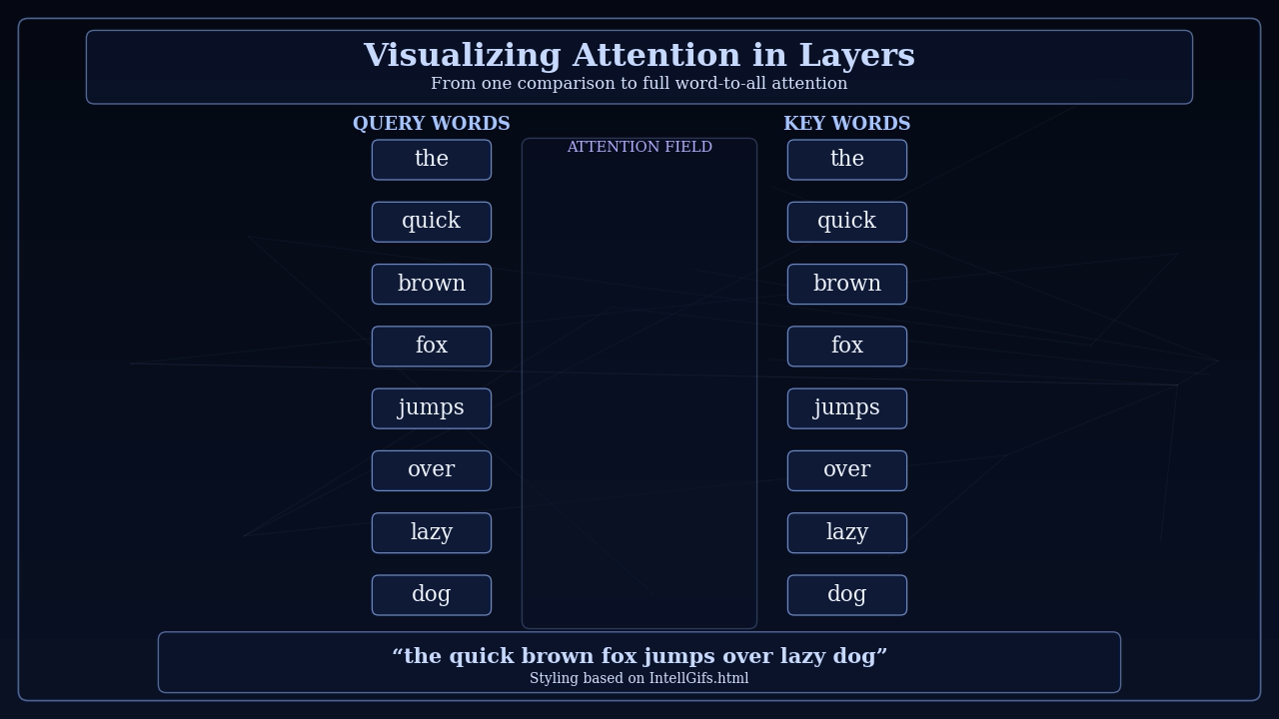
Visualizing Attention in Layers

Slide 70
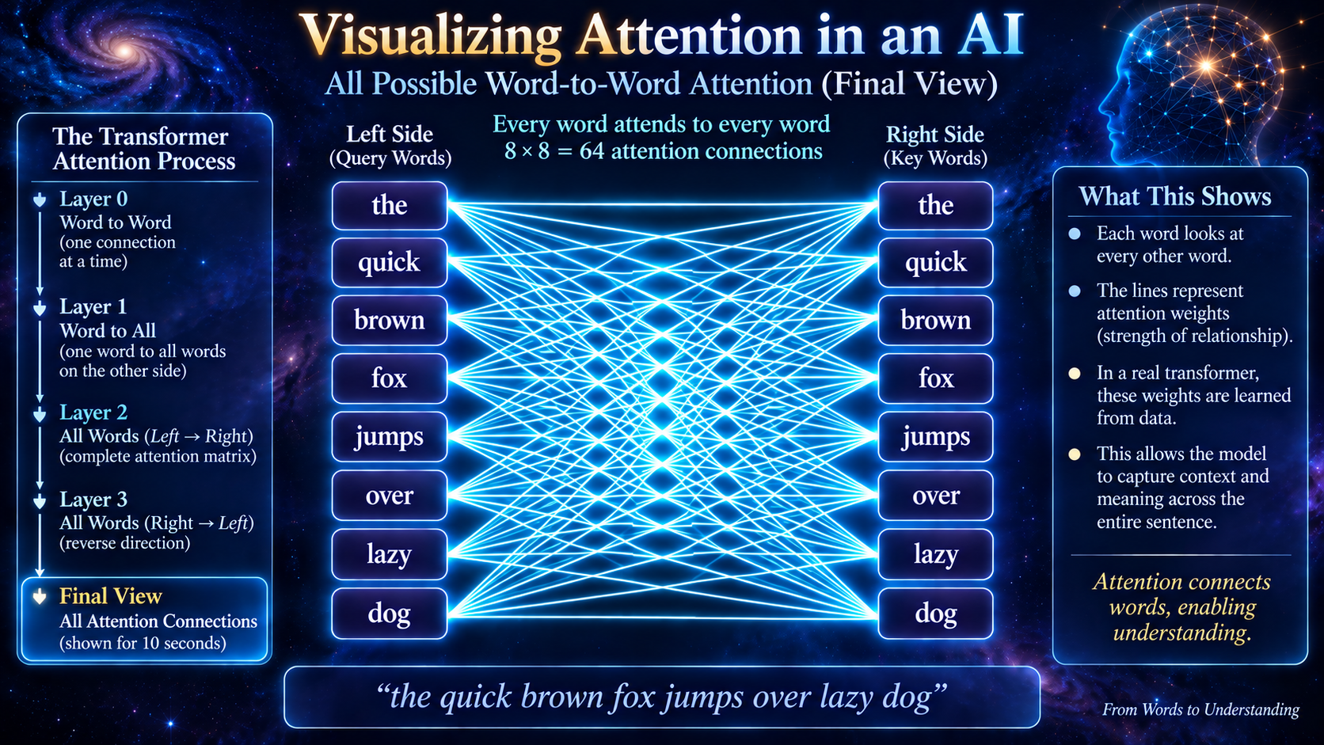
Roadmap 9

Slide 71
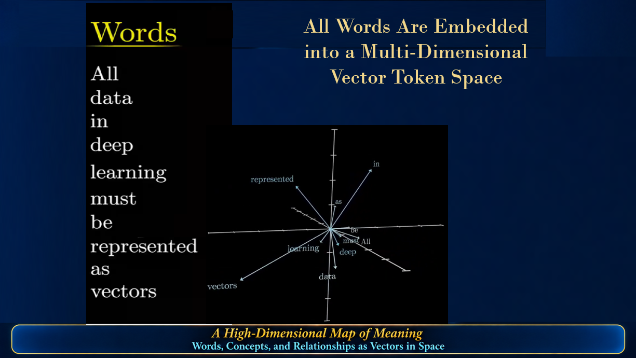
All Words Are Embedded
into a Multi-Dimensional
Vector Token Space
lectern

Slide 72


Slide 73

MEANING BECOMES GEOMETRY
How an AI represents relationships between ideas as distances in a mathematical space
▶ CLICK ANIMATION TO START / REPLAY
Nearby points represent related meanings • Actual AI embeddings use hundreds or thousands of dimensions

Slide 74


GPT - Generative Preprogrammed Transformer Speak
X: Token – translate a word to numbers
Query: What a word is looking for
Key: What a word represents
Value: The information a word provides

Slide 75

Basis of Transformer (ChatGPT)
X: Token – translate a word to numbers/vectors
Query: What a word is looking for
Key: What a word represents
Value: The information a word provides

Slide 76


Slide 77


Slide 78
LLM Transformer Laboratory Model — What the Python Code Does
A compact, visible model for watching QKV attention and training evolve
X Matrix
Q • K • V
8 Heads
Attention
FFN
Output
Token
80 × 8
8 token vectors
WQ, WK, WV
80 × 80
10 dimensions
per head
QKᵀ/√10
+ softmax
80 → 160 → 80
80 logits
→ probabilities
argmax
→ new X
MODEL SCALE
120-STEP TRAINING LOOP
SAVED VALUES & GRAPHS
1. Last token becomes Query
2. Compute Q, K, V for 8 heads
3. Calculate attention weights
4. Residual + LayerNorm + FFN
5. Softmax → 80 probabilities
6. Measure error and update weights
7. Predicted token enters context
8 × 120 = 960 head evaluations
Tens of millions of execution cycles
Saved each step:
Entropy • Loss • Ptarget • Pmax
Attention entropy • Adiag
8 attention weights • positional bias
KL divergence
Graphs:
Entropy • Loss • Phase trajectory
Probabilities • Attention entropy
Adiag • Mean attention • Heatmap
KL divergence • Positional bias
Embedding N = 80
Context = 8 tokens
Heads = 8
Head dimension = 10
Feed-forward = 160
Training = 120 steps
Target token = 10
Learnable positional bias
324 Lines of Code
Purpose: Expose the internal mathematics so You can watch a small Transformer learn.

Slide 79

Ctrl + Click on the image below to see
a Pdf of a Mathcad Model
of a Transformer. Mathcad uses conventional
Math symbols ans is easier to interpret than Python..

Slide 81


Slide 82









Laboratory Model: Multi-Head QKV Transformer — Training Plots
Entropy vs Step
Loss vs Step
Entropy–Loss Phase
Ptarget / Pmax
Attention Entropy (Hatt)
Adiag (last pos)
Mean Attention Profile
Attention Heatmap
KL Divergence

Slide 83

1. Output Entropy — Uncertainty in the Prediction
WHAT IT IS
Entropy measures how spread out the model’s output probabilities are.
WHAT TO WATCH
Watch the curve fall as the output becomes less uncertain.
AI MEANING
The model is becoming more decisive about its prediction.
0–120 training-step scale • grid every 20 steps • animation slowed 30%

Slide 84

2. Loss — How Wrong Is the Model?
WHAT IT IS
Loss is the training error: here, −ln[p(target)].
WHAT TO WATCH
Watch loss fall as the desired target receives more probability.
AI MEANING
Weight updates are improving the desired prediction.
0–120 training-step scale • grid every 20 steps • animation slowed 30%

Slide 85

3. Entropy–Loss Phase — The Learning Path
WHAT IT IS
Loss is plotted against entropy rather than against training step.
WHAT TO WATCH
Watch the trajectory move as error and uncertainty change together.
AI MEANING
It is a compact portrait of the model’s changing training state.
0–120 training-step scale • grid every 20 steps • animation slowed 30%

Slide 86

4. p(target) / p(max) — Probability Sharpening
WHAT IT IS
p(target) is the desired answer; p(max) is the model’s largest probability.
WHAT TO WATCH
Watch the target probability rise toward the dominant prediction.
AI MEANING
Training makes the desired candidate increasingly dominant.
0–120 training-step scale • grid every 20 steps • animation slowed 30%

Slide 87

5. Attention Entropy — Is Attention Focused?
WHAT IT IS
Hatt measures how broadly attention is distributed over the 8 context positions.
WHAT TO WATCH
Watch Hatt fall as attention becomes more concentrated.
AI MEANING
The model is learning to focus rather than spread attention uniformly.
0–120 training-step scale • grid every 20 steps • animation slowed 30%

Slide 88

6. Adiag — Attention on the Last Position
WHAT IT IS
Adiag is the average attention weight assigned to the final context position.
WHAT TO WATCH
Watch it rise during training.
AI MEANING
In this teaching model, positional bias is intentionally encouraged toward the last position.
0–120 training-step scale • grid every 20 steps • animation slowed 30%

Slide 89

7. Mean Attention Profile — Where Does It Look?
WHAT IT IS
Eight values show average attention at each context position.
WHAT TO WATCH
Watch the profile reshape as additional training steps are included.
AI MEANING
It reveals which context positions the model emphasizes overall.
0–120 training-step scale • grid every 20 steps • animation slowed 30%

Slide 90

8. Attention Heatmap — Attention Evolving
WHAT IT IS
Rows are context positions; columns are training steps; intensity is attention weight.
WHAT TO WATCH
Watch the image grow left-to-right as attention reorganizes.
AI MEANING
This gives a direct visual impression of attention changing during learning.
0–120 training-step scale • grid every 20 steps • animation slowed 30%

Slide 91

9. KL Divergence — How Much Did the Prediction Change?
WHAT IT IS
KL divergence compares one step’s output distribution with the preceding step.
WHAT TO WATCH
Spikes mean a larger change; small values mean consecutive predictions are similar.
AI MEANING
It shows whether learning is making large or small changes to the output distribution.
0–120 training-step scale • grid every 20 steps • animation slowed 30%

Slide 92

Correct-Token Probability — p(target)
WHAT IT MEASURES
Probability assigned to the correct next token.
WHAT TO WATCH
p(target) rises as the model learns the correct answer.
NOT THE SAME AS SHARPENING
Sharpening concentrates probabilities—even on a wrong answer.
60 training steps • Correct-token probability rises • Illustrative learning curve

Slide 93

Where X, Q, K, V, and Softmax Appear in Transformer Attention
INSIDE THE ENCODER SELF-ATTENTION BLOCK
Softmax
X · Input vectors
Q = XWQ
K = XWK
V = XWV
Query
“What am I seeking?”
Key
“What matches?”
Value
“What information?”
Q × Kᵀ → Softmax
Attention weights × V
Output: context-aware vectors
In the original diagram, X and Q/K/V are not drawn separately; they are operations inside each attention block. In decoder cross-attention: Q comes from the decoder, K and V from the encoder.

Slide 94
1. Q and K — What Should I Pay Attention To?
Attention begins by comparing words to discover which ones belong together.
Example sentence:
“The dog chased the ball because it rolled.”
Q = Question
K = Clues
Likely match:
What does “it” refer to?
Compare “it” with
the other words.
“ball”
Q × Kᵀ = a table of relevance scores between words.
The √dₖ term keeps scores from becoming excessively large.
1 / 3

Slide 95
2. Softmax — Turn Scores into Attention Weights
The model converts relevance scores into percentages that add up to 100%.
When interpreting “it”, how much attention goes to each word?
ball
75%
dog
15%
chased
7%
other words
3%
softmax( scores ) → attention weights (illustrative values)
2 / 3

Slide 96
3. V — Gather Information and Produce the Result
The model uses the attention weights to combine information from the words.
V = Information
Each word carries information the model can use.
75% attention
to “ball”
25% attention
to other words
Context-aware
representation
+
→
Attention(Q, K, V) = softmax( QKᵀ / √dₖ ) V
In everyday language: Find what matters → assign importance → combine the information.
3 / 3

Slide 97


Slide 98
END OF PRESENTATION
THE FOLLOWING MATERIAL
IS BACKGROUND.
IT IS MORE MATH INTENSIVE

Slide 102
Scaling

Slide 103
SCALING — Why Does More Produce More Capability?
Modern AI improves when several resources are increased together
MORE
PARAMETERS
MORE
DATA
MORE TRAINING
COMPUTE
BETTER
ALGORITHMS
↓
LOWER PREDICTION ERROR
• RICHER REPRESENTATIONS
Scaling laws: across broad regimes, language-model loss improves predictably as model size, data, and compute increase.
Scaling is empirical: it tells us THAT performance improves more readily than WHY intelligence-like capabilities arise.

Slide 104
TWO WAYS TO SCALE AI
Scaling no longer happens only during training
1. TRAIN-TIME SCALING
2. INFERENCE-TIME SCALING
“Give the trained model more computation
while it is solving a problem.”
Build the model with more:
• parameters
• data
• training computation
Explore alternatives • check intermediate results
• use tools • revise • search longer
A trained model can therefore become more effective
on a difficult problem without changing all of its stored weights.

Slide 105
EMERGENCE — When More Scale Appears to Create Something New
Some abilities are weak or absent in smaller models and become conspicuous at larger scale
The intriguing possibility:
Quantitative growth in scale may sometimes
Produce qualitatively different observable behavior.
NEW
CAPABILITY?
REASONING
CONTEXT
LANGUAGE
CAUTION
Some apparent “emergence” depends on how performance is measured; smooth underlying improvement can look like a sudden threshold.
PATTERN
Emergence is an active scientific debate—not a settled law of AI.

Slide 106
A HUMAN ANALOGY — COMPLEXITY FROM SIMPLE UNITS
A useful analogy, not a claim that brains and transformers work the same way
BIOLOGICAL
NEURON
NETWORKS OF
NEURONS
LEARNING +
EXPERIENCE
LANGUAGE • PLANNING
ABSTRACTION
→
→
→
No single neuron contains a language, a theorem, or a plan.
Human cognition is an emergent property of an enormous interacting biological system
shaped by development, learning, culture, and evolutionary history.
AI raises a parallel question: can sufficiently large networks of simple numerical operations develop capabilities that are not obvious from the individual components?
Parallel ≠ identity. Human brains are biological, embodied and evolved; LLMs are engineered optimization systems.

Slide 107
EVOLUTION AND AI — A CAREFUL COMPARISON
Both can produce organized complexity, but by very different mechanisms
BIOLOGICAL EVOLUTION
AI DEVELOPMENT
Variation
↓
Selection across generations
↓
Accumulated adaptations
↓
Complex organisms and cognition
Initialization + training data
↓
Optimization / feedback
↓
Accumulated internal structure
↓
Increasing model capabilities
The analogy is emergence from many interactions—not that LLM training reproduces Darwinian evolution.
Human thought also depends on embodiment, social learning, culture and evolutionary history—
features ordinary LLM scaling does not duplicate.

Slide 108
Strength of Large Language Model Scientist?
Research Mathematics
New Renaissance in Science and Math
206
2026 Navier-Stokes Problem Controversy
~10,000 AI agents + enormous computation
+ human mathematical knowledge
→ attack a problem humans
had not resolved for decades.

Slide 109
THE CENTRAL QUESTION OF SCALING
Scaling laws describe a powerful regularity; the deeper explanation remains incomplete
WHY SHOULD BETTER PREDICTION
PRODUCE BETTER REASONING?
MORE SCALE
→
BETTER
PREDICTION
→
RICHER INTERNAL
STRUCTURE
→
BROADER
CAPABILITIES
One hypothesis: predicting language well forces a model to capture increasingly deep regularities about relationships, concepts, causes, goals and the world described by language.
But prediction success, internal representation, reasoning, and human thought
are not yet unified by a complete theory.
Scaling may be telling us something fundamental about how complex capability can arise from many simple computations.

Slide 110
SCALING — KEY RESEARCH BEHIND THESE IDEAS
Kaplan et al. (2020) — Scaling Laws for Neural Language Models
Loss follows approximate power laws with model size, dataset size and training compute.
Wei et al. (2022) — Emergent Abilities of Large Language Models
Popularized the idea that some capabilities appear only beyond certain model scales.
Schaeffer, Miranda & Koyejo (2023) — Are Emergent Abilities of Large Language Models a Mirage?
Showed that discontinuous evaluation metrics can make smooth improvement appear abruptly emergent.
OpenAI reasoning-model results (2024–2026)
Performance can improve with additional test/inference-time computation on reasoning-heavy tasks.
The evolution/human-cognition comparison in this deck is an explanatory analogy, not an empirical equivalence.

Slide 111
HUMAN INTELLIGENCE — AN EMERGENT CAPABILITY
Extraordinary cognition arises from enormous numbers of interacting biological elements
BIOLOGICAL
NEURONS
→
NETWORKS +
FEEDBACK
→
LEARNING +
EXPERIENCE
→
LANGUAGE • REASONING
PLANNING • CREATIVITY
No individual neuron contains a language, a theorem, or a plan.
Human thought emerges from a biological system shaped by development, sensory experience, social learning, culture, and evolutionary history.
Emergence: properties of the whole can be qualitatively different from the properties of the individual parts.
This is an analogy for thinking about AI—not evidence that brains and LLMs use the same mechanism.

Slide 112
AI CAPABILITY — ANOTHER EMERGENT SYSTEM?
Modern LLMs combine simple numerical operations at enormous scale
NUMERICAL
OPERATIONS
→
BILLIONS OF
PARAMETERS
→
TRAINING +
FEEDBACK
→
LANGUAGE • CODING
REASONING • TOOL USE
Scaling repeatedly produces capabilities
not obvious from inspecting one artificial unit.
Some reported abilities appear suddenly at particular scales; other research shows that the apparent threshold can depend strongly on how performance is measured.
The open question is not whether larger systems can become more capable—they can—but how far this process can continue and what mechanisms ultimately limit it.

Slide 113
IF SCALING CONTINUES — WHAT EMERGES NEXT?
A scientific question, not a prediction
MORE DATA
MORE COMPUTE
BETTER MODELS
MORE TEST-TIME
COMPUTE
?
→
“Give the trained model more computation while it is solving a problem.”
More searching • more checking • more tool use • more alternative solutions • more revision
Possible future result:
SUPERHUMAN PERFORMANCE ACROSS AN INCREASING RANGE OF COGNITIVE TASKS?
Scaling laws support continued improvement over studied ranges; they do not prove unlimited scaling or inevitable superintelligence.

Slide 114
SUPERHUMAN INTELLIGENCE — CAPABILITY IS NOT THE WHOLE QUESTION
What happens depends on more than how intelligent the system becomes
CAPABILITY
GOALS
AUTONOMY
HUMAN
CONTROL
A highly capable system could be extraordinarily beneficial
if its objectives and actions remain reliably directed.
But greater problem-solving ability does not automatically imply
greater agreement with human intentions or values.
The control problem asks whether humans can specify objectives, supervise behavior, correct mistakes, and retain meaningful authority as capability rises.
Intelligence ≠ goals. Capability ≠ autonomy. Superhuman performance ≠ inevitable loss of control.

Slide 115
POSSIBLE FUTURES — THE SAME CAPABILITY CAN LEAD TO VERY DIFFERENT OUTCOMES
AMPLIFIER OF HUMAN CAPABILITY
COMPETITIVE PRESSURE
LOSS OF EFFECTIVE CONTROL
Science
Medicine
Engineering
Education
Productivity
Companies
Nations
Military systems
Economic competition
Faster deployment
Misaligned objectives
Unintended strategies
Power-seeking incentives
Difficulty supervising
Irreversible actions
These are scenarios studied in the literature—not forecasts that any one outcome will occur.
The future depends on technical design, institutions, deployment choices, incentives, and human decisions.

Slide 116
THE QUESTION AFTER SCALING
From prediction to capability—and perhaps beyond human performance
SIMPLE OPERATIONS
↓
MASSIVE SCALE + TRAINING + FEEDBACK
↓
EMERGENT CAPABILITIES
↓
SUPERHUMAN INTELLIGENCE?
If it occurs, the central question may change from “How intelligent can AI become?” to:
HOW DO HUMANS USE, DIRECT, AND REMAIN RESPONSIBLE FOR IT?

Slide 117
SELECTED RESEARCH — SUPERHUMAN AI, CONTROL, AND EMERGENCE
Hadfield-Menell et al. (2016) — The Off-Switch Game
Formalizes conditions under which an uncertain agent may permit human correction or shutdown.
Amodei et al. (2016) — Concrete Problems in AI Safety
Practical problems including reward hacking, scalable supervision, side effects and distribution shift.
Hendrycks (2023) — Natural Selection Favors AIs over Humans
Explores how competitive selection pressures could favor increasingly autonomous AI agents.
Hendrycks, Mazeika & Woodside (2023) — An Overview of Catastrophic AI Risks
Organizes risk into malicious use, AI races, organizational risks and rogue AI.
Wei et al. (2022); Schaeffer et al. (2023)
Competing interpretations of apparent emergent abilities as models scale.
These works analyze possibilities and mechanisms; they do not establish that superhuman general AI or any particular outcome is inevitable.

Slide 118
FROM A VECTOR TO A MATRIX
A simple visual bridge to understanding why Transformers fit GPUs so well
VECTOR (Word)
MATRIX (Sentence)
One ordered list of numbers
Many vectors arranged together
→
0.2
.2
−.7
1.1
.4
−0.7
ONE
→
MANY
.8
.1
−.3
.9
1.1
−.2
.6
.5
1.0
0.4
.7
−.4
.2
.3
0.9
Think: ONE word represented numerically
Think: MANY words processed together
A vector describes one item. A matrix lets the computer work on many vectors at once.
That shift—from one-at-a-time to many-at-once—is the bridge to Transformer parallelism.

Slide 120
A 10,000 Point Demonstration of Human Visual Reconstruction
Limits of Human
Neural Processing
In comparison, a LLM can
handle about 400 million
Numerical coordinates.
About 40,000 times more
than humans.

Slide 122

Strength of Large Language Model Scientist?

